Slide 1
Kubernetes
Kubernetes Up & Running
Part V
2026.08.25

Slide 2
Integrating Storage Solutions and Kubernetes

Slide 3
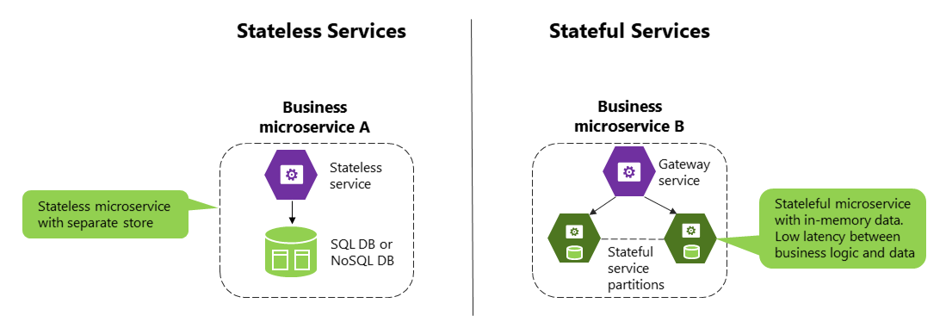
Introduction(1/2)
Decoupling, Immutability, and Declarative Application :
  In many cases, decoupling state from applications and building your microservices to be as “stateless“ as possible results in maximally reliable, manageable systems. However, nearly every system that has any complexity has state in the system somewhere, from the records in a database to the index shards that serve results for a web search engine. At some point, you have to have data stored somewhere.
  Integrating this data with containers and container orchestration solutions is often the most complicated aspect of building a distributed system. This complexity largely stems from the fact that the move to containerized architectures is also a move toward decoupled, immutable, and declarative application development. These patterns are relatively easy to apply to stateless web applications, but even “cloud-native” storage solutions like Cassandra or MongoDB involve some sort of manual or imperative steps to set up a reliable, replicated solution.

Slide 4
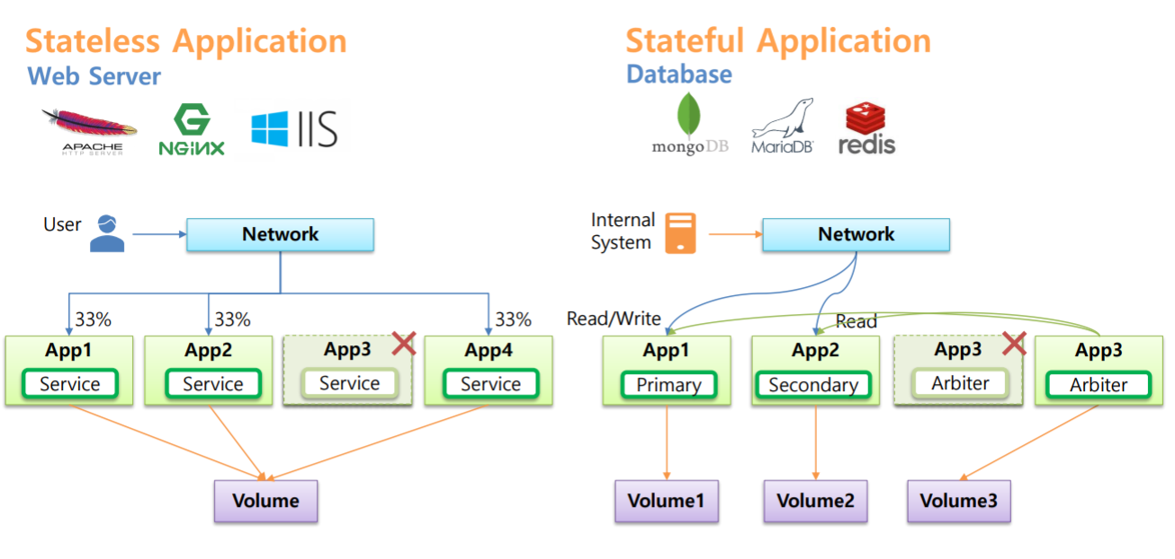
Introduction(2/2)
StatefulSets :
  Additional complexity comes from the fact that there is “data gravity”. Most containerized systems aren’t built in a vacuum; they are usually adapted from existing systems deployed onto VM(Virtual Machine)s, and these systems likely include data that has to be imported or migrated.
  Evolution to the cloud often means that storage is an externalized cloud service, and in that context it can never really exist inside of the Kubernetes cluster.
  Here we will talk about the following topics -
    How to import existing external storage solutions (either cloud services or running on VMs) into Kubernetes.
    How to run reliable singletons inside of Kubernetes that enable you to have an environment that largely matches the VMs where you previously deployed storage solutions.
    The StatefulSets represent the stateful workloads in Kubernetes.

Slide 5
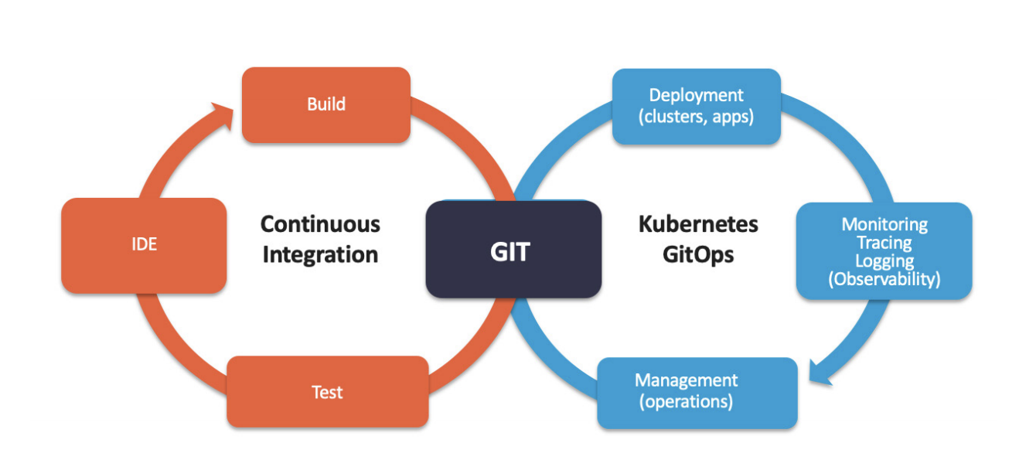
Importing External Services(1/8)
Continuous Deployment :
  When you represent the legacy server and service in Kubernetes, you get to take advantage of all of the built-in naming and service-discovery primitives provided by Kubernetes. Additionally, this enables you to configure all your applications so that it looks like the database that is running on a machine somewhere is actually a Kubernetes service. This means that it is trivial to replace it with a database that is a Kubernetes service.
  For example, in production, you may rely on your legacy database that is running on a machine, but for continuous testing you may deploy a test database as a transient container. Since it is created and destroyed for each test run, data persistence isn’t important in the continuous testing case. Representing both databases as Kubernetes services enables you to maintain identical configurations in both testing and production. High fidelity between test and production ensures that passing tests will lead to successful deployment in production.

Slide 6
Importing External Services(2/8)
Continuous Deployment(CD) :
  To see concretely how you maintain high fidelity between development and production, remember that all Kubernetes objects are deployed into namespaces. Imagine that we have test and production namespaces defined. The test service is imported using an object like :
  The production service looks the same, except it uses a “different namespace” :
kind: Service
metadata:
name: my-database
# note 'test' namespace here
namespace: test
...
kind: Service
metadata:
name: my-database
# note 'prod' namespace here
namespace: prod
...

Slide 7
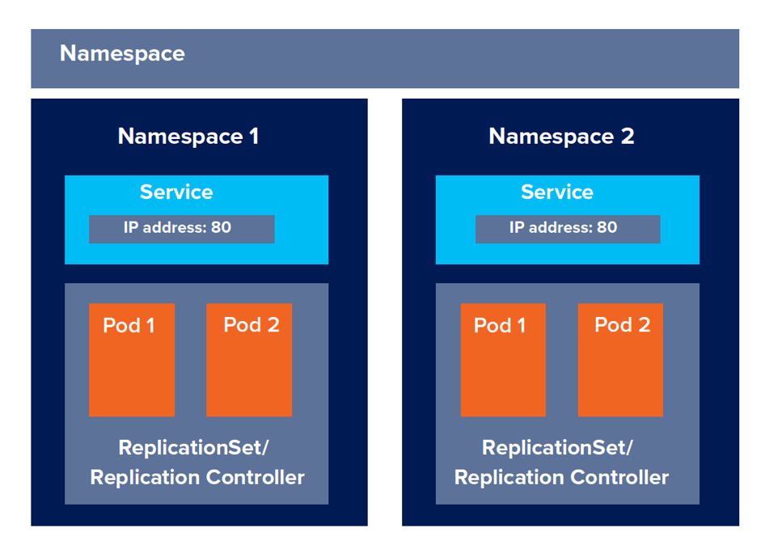
Importing External Services(3/8)
Continuous Deployment :
  When you deploy a Pod into the test namespace and it looks up the service named “my-database”, it will receive a pointer to “my-database.test.svc.cluster.internal”, which in turn points to the “test database”. In contrast, when a Pod deployed in the prod namespace looks up the same name (“my-database”) it will receive a pointer to “my-database.prod.svc.cluster.internal”, which is the “production database”. Thus, the same service name, in two different namespaces, resolves to two different services.
  NOTE : The following techniques all use database or other storage services, but these approaches can be used equally well with other services that aren’t running inside your Kubernetes cluster.
Test
Production

Slide 8
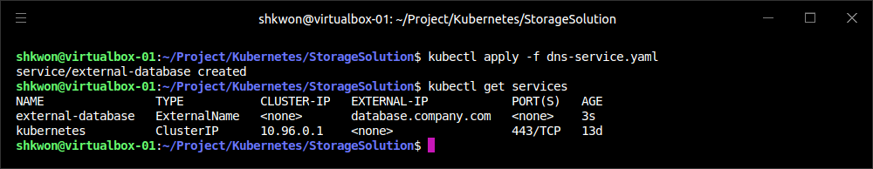
Importing External Services(4/8)
Services Without Selectors :
  With external services, there is no label query. Instead, you generally have a “DNS name” that points to the specific server running the database. For our example, let’s assume that this server is named “database.company.com”. To import this external database service into Kubernetes, we start by creating a service without a Pod selector that references the DNS name of the database server.
kind: Service
apiVersion: v1
metadata:
name: external-database
spec:
type: ExternalName
externalName: database.company.com

Slide 9
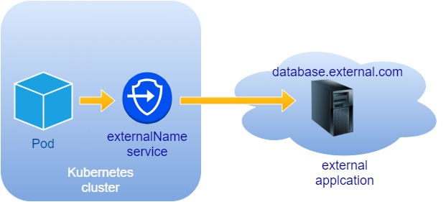
Importing External Services(5/8)
Services Without Selectors :
  When a typical Kubernetes service is created, an IP address is also created and the Kubernetes DNS service is populated with an A record that points to that IP address. When you create a service of type “ExternalName”, the Kubernetes DNS service is instead populated with a “CNAME record“ that points to the external name you specified (“database.company.com” in this case). When an application in the cluster does a DNS lookup for the hostname “external-database.svc.default.cluster”, the DNS protocol aliases that name to “database.company.com”. This then resolves to the IP address of your external database server. In this way, all containers in Kubernetes believe that they are talking to a service that is backed with other containers, when in fact they are being redirected to the external database.
  NOTE : This is not restricted to databases you are running on your own infrastructure. Many cloud databases and other services provide you with a DNS name to use when accessing the database (e.g., “my-database.databases.cloudprovider.com”). You can use this DNS name as the “externalName”. This imports the cloud-provided database into the namespace of your Kubernetes cluster.

Slide 10
Importing External Services(6/8)
Services Without Selectors :
  Sometimes, however, you don’t have a DNS address for an external database service, just an IP address. In such cases, it is still possible to import this service as a Kubernetes service, but the operation is a little different. First, you create a Service without a label selector, but also without the “ExternalName” type we used before.
  At this point, Kubernetes will allocate a virtual IP address for this service and populate an “A record” for it. However, because there is no selector for the service, there will be no endpoints populated for the load balancer to redirect traffic to.
kind: Service
apiVersion: v1
metadata:
name: external-ip-database

Slide 11
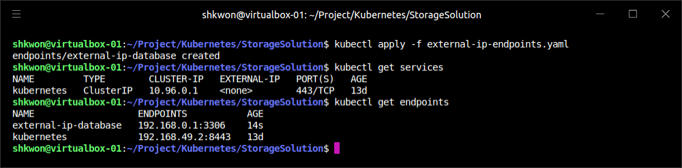
Importing External Services(7/8)
Services Without Selectors :
  Given that this is an external service, the user is responsible for populating the endpoints manually with an Endpoints resource.
kind: Endpoints
apiVersion: v1
metadata:
name: external-ip-database
subsets:
- addresses:
- ip: 192.168.0.1
ports:
- port: 3306

Slide 12
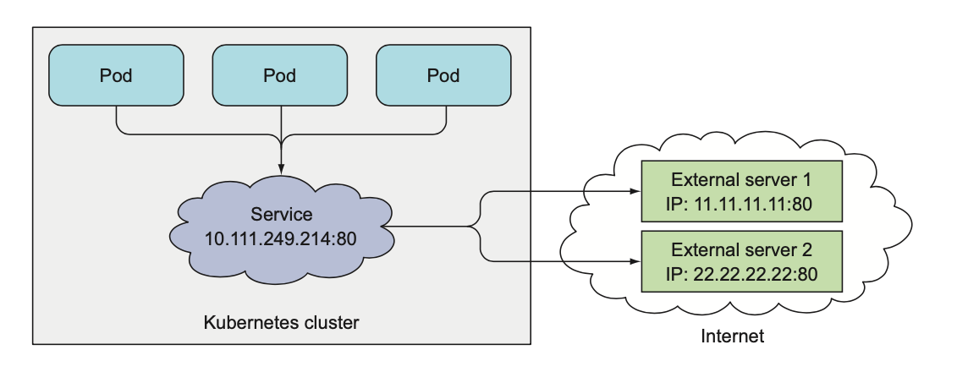
Importing External Services(8/8)
Services Without Selectors :
  If you have more than one IP address for redundancy, you can repeat them in the addresses array in YAML file. Once the endpoints are populated, the load balancer will start redirecting traffic from your Kubernetes service to the IP address endpoint(s).
  NOTE : Because the user has assumed responsibility for keeping the IP address of the server up to date, you need to either ensure that it never changes or make sure that some automated process updates the Endpoints record.
  NOTE : Limitations of External Services : Health Checking - External services in Kubernetes have one significant restriction. They do not perform any health checking. The user is responsible for ensuring that the endpoint or DNS name supplied to Kubernetes is as reliable as necessary for the application.

Slide 13
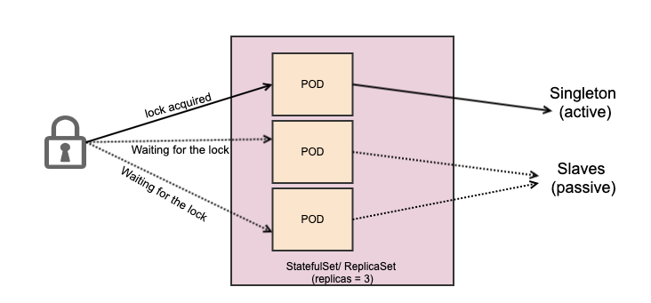
Running Reliable Singletons(1/10)
Singletons for Data Storage Solution :
  The challenge of running storage solutions in Kubernetes is often that primitives like ReplicaSet expect that every container is identical and replaceable, but for most storage solutions this isn’t the case. One option to address this is to use Kubernetes primitives, but not attempt to replicate the storage. Instead, simply run a single Pod that runs the database or other storage solution. In this way the challenges of running replicated storage in Kubernetes don’t occur, since there is no replication.
  At first blush, this might seem to run counter to the principles of building reliable distributed systems, but in general, it is no less reliable than running your database or storage infrastructure on a single virtual or physical machine, which is how many people currently have built their systems. Indeed, in reality, if you structure the system properly the only thing you are sacrificing is potential downtime for upgrades or in case of machine failure. While for large-scale or mission-critical systems this may not be acceptable, for many smaller-scale applications this kind of limited downtime is a reasonable trade-off for the reduced complexity.

Slide 14
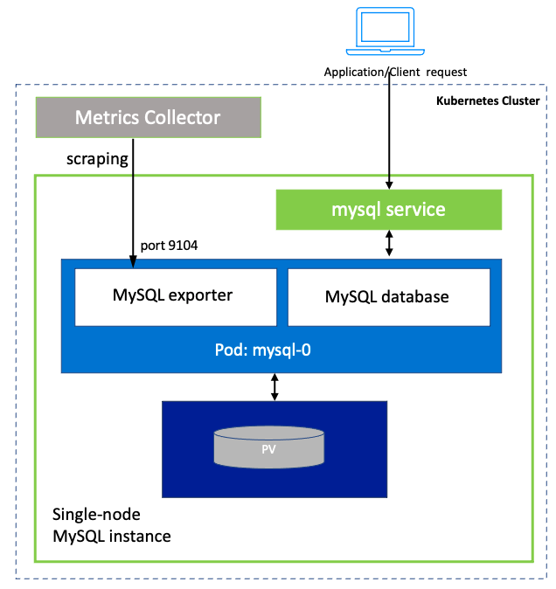
Running Reliable Singletons(2/10)
Running a MySQL Singleton :
  Here we’ll describe how to run a reliable singleton instance of the MySQL database as a Pod in Kubernetes, and how to expose that singleton to other applications in the cluster.
  To do this, we are going to create three basic objects :
    A persistent volume to manage the lifespan of the on-disk storage independently from the lifespan of the running MySQL application
    A MySQL Pod that will run the MySQL application
    A service that will expose this Pod to other containers in the cluster

Slide 15
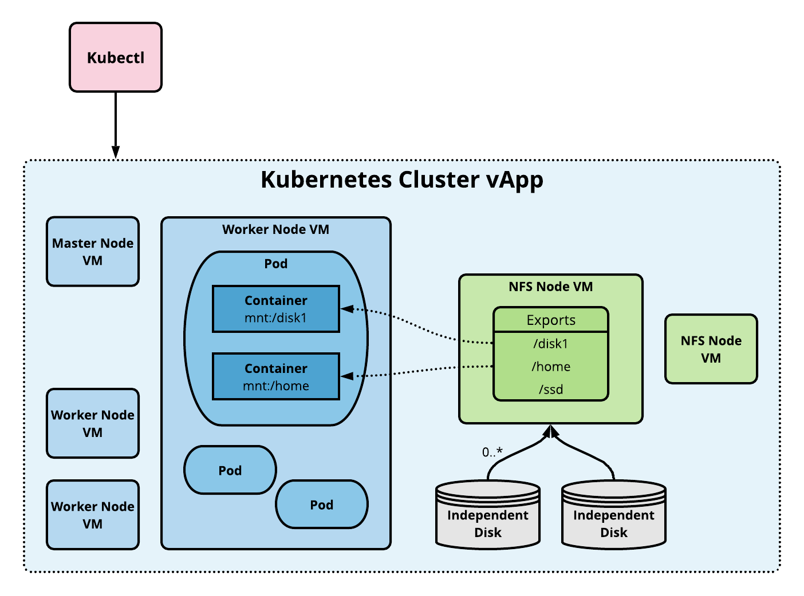
Running Reliable Singletons(3/10)
Running a MySQL Singleton :
  A persistent volume(PV) is a storage location that has a lifetime independent of any Pod or container. This is very useful in the case of persistent storage solutions where the on-disk representation of a database should survive even if the containers running the database application crash, or move to different machines. If the application moves to a different machine, the volume should move with it, and data should be preserved. Separating the data storage out as a persistent volume makes this possible.
  To begin, we’ll create a persistent volume for our MySQL database to use. This example uses NFS(Network File System) for maximum portability, but Kubernetes supports many different persistent volume drive types. For example, there are persistent volume drivers for all major public cloud providers, as well as many private cloud providers. To use these solutions, simply replace NFS with the appropriate cloud provider volume type (e.g., azure, awsElasticBlockStore, or gcePersistentDisk). In all cases, this change is all you need. Kubernetes knows how to create the appropriate storage disk in the respective cloud provider.

Slide 16
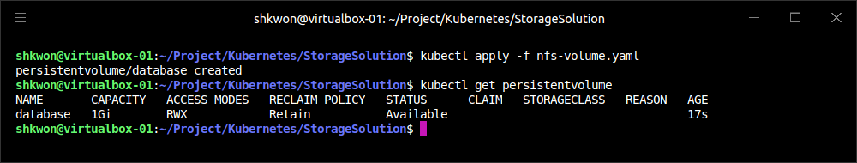
Running Reliable Singletons(4/10)
Running a MySQL Singleton :
  The following manifest defines an “NFS PersistentVolume object” with 1 GB of storage space. We can create this persistent volume as usual with “kubectl apply -f” command :
apiVersion: v1
kind: PersistentVolume
metadata:
name: database
labels:
volume: my-volume
spec:
accessModes:
- ReadWriteMany
capacity:
storage: 1Gi
nfs:
server: 192.168.0.1
path: "/exports"
nfs-volume.yaml
$ kubectl apply -f nfs-volume.yaml

Slide 17
Running Reliable Singletons(5/10)
Running a MySQL Singleton :
  Now that we have a persistent volume created, we need to claim that persistent volume for our Pod. We do this with a “PersistentVolumeClaim” object.
  The “selector” field uses labels to find the matching volume we defined previously. This kind of indirection may seem overly complicated, but it has a purpose—it serves to isolate our Pod definition from our storage definition. You can declare volumes directly inside a Pod specification, but this locks that Pod specification to a particular volume provider (e.g., a specific public or private cloud).
  By using volume claims, you can keep your Pod specifications cloud-agnostic; simply create different volumes, specific to the cloud, and use a “PersistentVolumeClaim” to bind them together. Furthermore, in many cases, the “persistent volume controller” will actually automatically create a volume for you.
kind: PersistentVolumeClaim
apiVersion: v1
metadata:
name: database
spec:
accessModes:
- ReadWriteMany
resources:
requests:
storage: 1Gi
selector:
matchLabels:
volume: my-volume
nfs-volume-claim.yaml

Slide 18
Running Reliable Singletons(6/10)
Running a MySQL Singleton :
  Now that we’ve claimed our volume, we can use a “ReplicaSet” to construct our singleton Pod. It might seem odd that we are using a ReplicaSet to manage a single Pod, but it is necessary for reliability. Remember that once scheduled to a machine, a bare Pod is bound to that machine forever. If the machine fails, then any Pods that are on that machine that are not being managed by a higher-level controller like a “ReplicaSet” vanish along with the machine and are not rescheduled elsewhere. To ensure that our database Pod is rescheduled in the presence of machine failures, we use the higher-level “ReplicaSet controller”, with a replica size of one.
apiVersion: apps/v1
kind: ReplicaSet
metadata:
name: mysql
# labels so that we can bind a Service to this Pod
labels:
app: mysql
spec:
replicas: 1
selector:
matchLabels:
app: mysql
template:
metadata:
labels:
app: mysql
spec:
containers:
- name: database
image: mysql
resources:
requests:
cpu: 1
memory: 2Gi
env:
# Environment variables are not a best practice for security,
# but we're using them here for brevity in the example.
- name: MYSQL_ROOT_PASSWORD
value: some-password-here
livenessProbe:
tcpSocket:
port: 3306
ports:
- containerPort: 3306
volumeMounts:
- name: database
# /var/lib/mysql is where MySQL stores its databases
mountPath: "/var/lib/mysql"
volumes:
- name: database
persistentVolumeClaim:
claimName: database
mysql-replicaset.yaml

Slide 19
Running Reliable Singletons(7/10)
Running a MySQL Singleton :
  Once we create the ReplicaSet it will, in turn, create a Pod running MySQL using the persistent disk we originally created. The final step is to “expose this as a Kubernetes service”.
  NOTE : Now we have a reliable singleton MySQL instance running in our cluster and exposed as a service named “mysql”, which we can access at the full domain name “mysql.svc.default.cluster”. Similar instructions can be used for a variety of data stores, and if your needs are simple and you can survive limited downtime in the face of a machine failure or when you need to upgrade the database software, a reliable singleton may be the right approach to storage for your application.
apiVersion: v1
kind: Service
metadata:
name: mysql
spec:
ports:
- port: 3306
protocol: TCP
selector:
app: mysql
msql-service.yaml

Slide 20
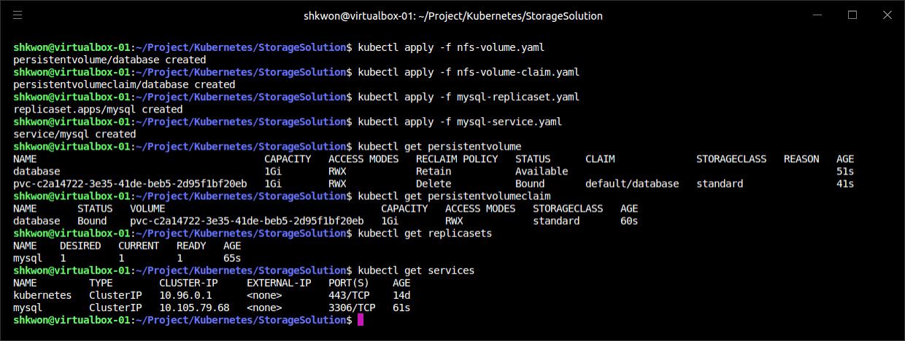
NOTE : Running All Together
MySQL Service :
  You can use “kubectl apply -f” command to each YAML files. See the following screenshot.
$ kubectl apply -f nfs-volume.yaml
$ kubectl apply -f nfs-volume-claim.yaml
$ kubectl apply -f mysql-replicaset.yaml
$ kubectl apply -f mysql-service.yaml

Slide 21
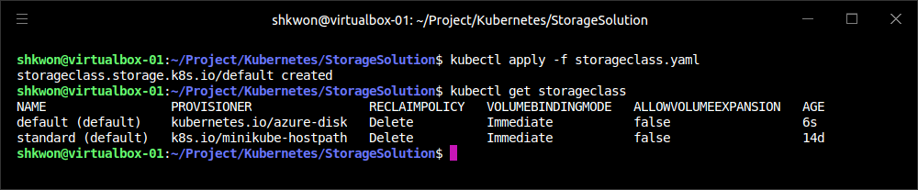
Running Reliable Singletons(8/10)
Dynamic Volume Provisioning :
  Many clusters also include “dynamic volume provisioning”. With dynamic volume provisioning, the cluster operator creates one or more “StorageClass“ objects. The following manifest shows a default storage class that automatically provisions disk objects on the Microsoft Azure platform.
apiVersion: storage.k8s.io/v1
kind: StorageClass
metadata:
name: default
annotations:
storageclass.beta.kubernetes.io/is-default-class: "true"
labels:
kubernetes.io/cluster-service: "true"
provisioner: kubernetes.io/azure-disk
storageclass.yaml

Slide 22
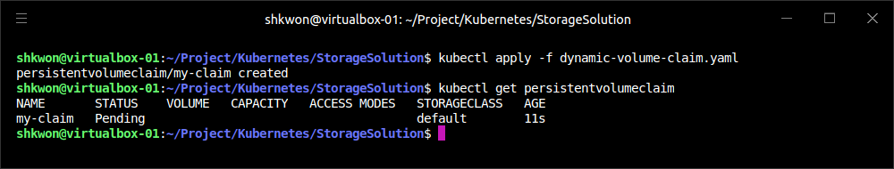
Running Reliable Singletons(9/10)
Dynamic Volume Provisioning :
  Once a storage class has been created for a cluster, you can refer to this storage class in your persistent volume claim, rather than referring to any specific persistent volume. When the dynamic provisioner sees this storage claim, it uses the appropriate volume driver to create the volume and bind it to your persistent volume claim.
  The following manifest shows an example of a “PersistentVolumeClaim” that uses the default storage class we just defined to claim a newly created persistent volume.
kind: PersistentVolumeClaim
apiVersion: v1
metadata:
name: my-claim
annotations:
volume.beta.kubernetes.io/storage-class: default
spec:
accessModes:
- ReadWriteOnce
resources:
requests:
storage: 10Gi
dynamic-volume-claim.yaml

Slide 23
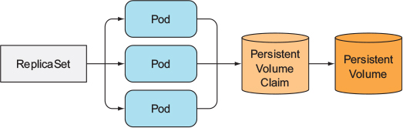
Running Reliable Singletons(10/10)
Dynamic Volume Provisioning :
  The “volume.beta.kubernetes.io/storage-class” annotation is what links this claim back up to the storage class we created.
  NOTE : Automatic provisioning of a persistent volume is a great feature that makes it significantly easier to build and manage stateful applications in Kubernetes. However, the lifespan of these persistent volumes is dictated by the reclamation policy of the “PersistentVolumeClaim” and the default is to bind that lifespan to the lifespan of the Pod that creates the volume.
  NOTE : This means that if you happen to delete the Pod (e.g., via a scaledown or other event), then the volume is deleted as well. While this may be what you want in certain circumstances, you need to be careful to ensure that you don’t accidentally delete your persistent volumes.
  Persistent volumes are great for traditional applications that require storage, but if you need to develop high-availability, scalable storage in a Kubernetes-native fashion, the newly released “StatefulSet“ object can be used instead.

Slide 24
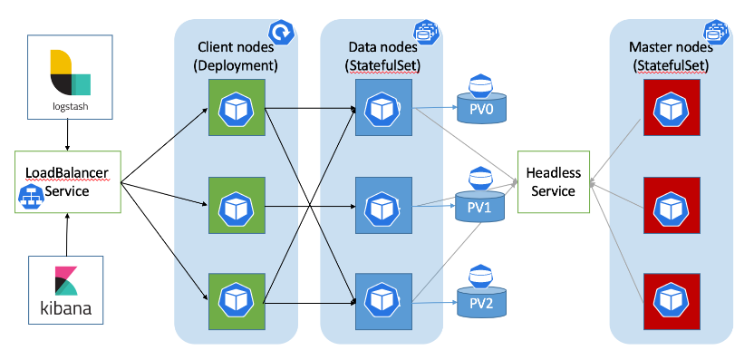
Kubernetes-Native Storage with StatefulSets(1/15)
StatefulSets :
  When Kubernetes was first developed, there was a heavy emphasis on homogeneity for all replicas in a replicated set. In this design, no replica had an individual identity or configuration. It was up to the application developer to determine a design that could establish this identity for their application.
  While this approach provides a great deal of isolation for the orchestration system, it also makes it quite difficult to develop stateful applications. After significant input from the community and a great deal of experimentation with various existing stateful applications, “StatefulSets” were introduced in Kubernetes version 1.5.

Slide 25
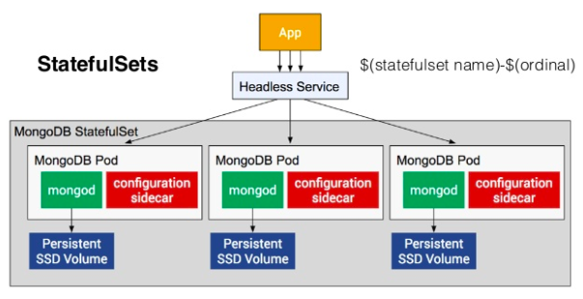
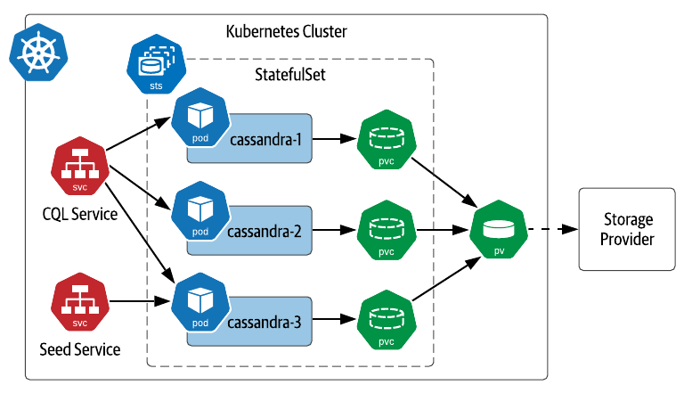
Kubernetes-Native Storage with StatefulSets(2/15)
Properties of StatefulSets :
  StatefulSets are replicated groups of Pods, similar to ReplicaSets. But unlike a ReplicaSet, they have certain unique properties :
    Each replica gets a persistent hostname with a unique index (e.g., database-0, database-1, etc.).
    Each replica is created in order from lowest to highest index, and creation will block until the Pod at the previous index is healthy and available. This also applies to scaling up.
    When a StatefulSet is deleted, each of the managed replica Pods is also deleted in order from highest to lowest. This also applies to scaling down the number of replicas.
  It turns out that this simple set of requirements makes it drastically easier to deploy storage applications on Kubernetes. For example, the combination of stable hostnames (e.g., “database-0”) and the ordering constraints mean that all replicas, other than the first one, can reliably reference “database-0” for the purposes of discovery and establishing replication quorum.

Slide 26
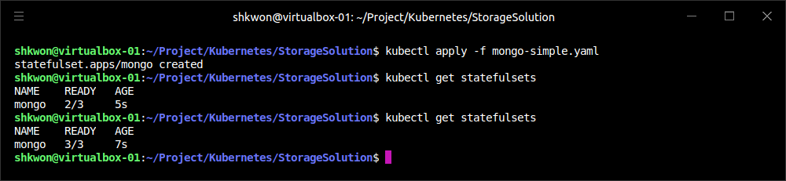
Kubernetes-Native Storage with StatefulSets(3/15)
Manually Replicated MongoDB with StatefulSets :
  Here we’ll deploy a replicated MongoDB cluster. To start, we’ll create a replicated set of three MongoDB Pods using a StatefulSet object.
apiVersion: apps/v1
kind: StatefulSet
metadata:
name: mongo
spec:
selector:
matchLabels:
app: mongo
serviceName: "mongo"
replicas: 3
template:
metadata:
labels:
app: mongo
spec:
containers:
- name: mongodb
image: mongo:3.4.1
command:
- mongod
- --replSet
- rs0
ports:
- containerPort: 27017
name: peer
mongo-simple.yaml

Slide 27
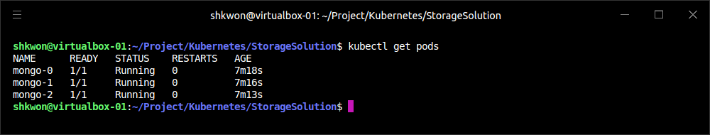
Kubernetes-Native Storage with StatefulSets(4/15)
Manually Replicated MongoDB with StatefulSets :
  The definition is similar to the ReplicaSet definitions. The only changes are in the “kind” fields. To create the StatefulSet, use the following command :
  Once created, the differences between a ReplicaSet and a StatefulSet become apparent. Run “kubectl get pods” and you will likely see :
  There are two important differences between this and what you would see with a ReplicaSet. The first is that each replicated Pod has a numeric index (0, 1, …), instead of the random suffix that is added by the ReplicaSet controller. The second is that the Pods are being slowly created in order, not all at once as they would be with a ReplicaSet.
$ kubectl apply -f mongo-simple.yaml

Slide 28
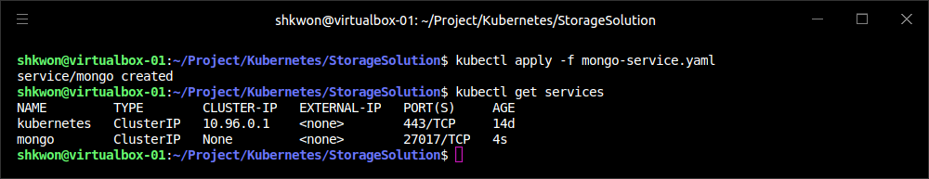
Kubernetes-Native Storage with StatefulSets(5/15)
Manually Replicated MongoDB with StatefulSets :
  Once the StatefulSet is created, we also need to create a “headless*” service to manage the DNS entries for the StatefulSet. In Kubernetes a service is called “headless” if it doesn’t have a cluster virtual IP address. Since with StatefulSets each Pod has a unique identity, it doesn’t really make sense to have a load-balancing IP address for the replicated service. You can create a headless service using “clusterIP: None” in the service specification.
apiVersion: v1
kind: Service
metadata:
name: mongo
spec:
ports:
- port: 27017
name: peer
clusterIP: None
selector:
app: mongo
* 소프트웨어와 웹 개발에서 '헤드리스(Headless)'는 화면(UI, Head)과 데이터 처리 및 로직(Backend)을 분리하여, 시각적 요소에 얽매이지 않고 유연하게 시스템을 운영하는 아키텍처 패턴을 뜻합니다
mongo-service.yaml
kubctl apply -f mongo-service.yaml

Slide 29
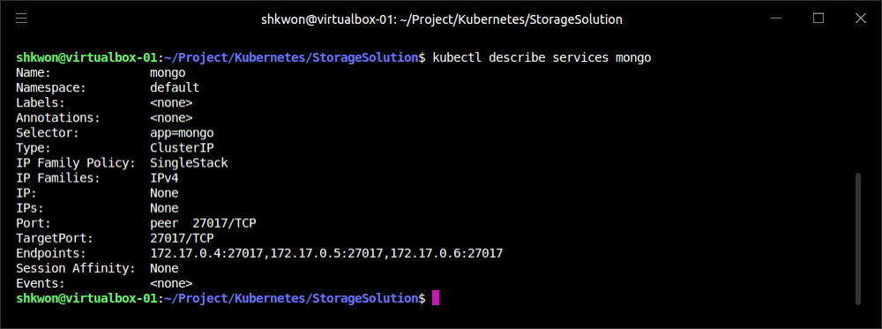
NOTE : The “Mongo” Service
The Detailed Information :
  You can use “kubectl describe sevices mongo” command to see the detailed information about the running service.
$ kubectl describe sevices mongo

Slide 30
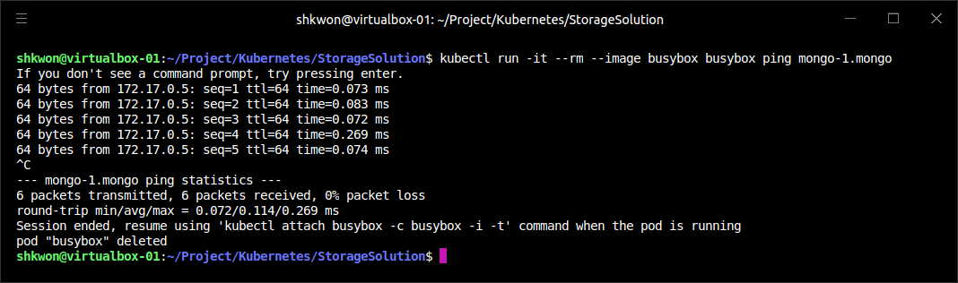
Kubernetes-Native Storage with StatefulSets(6/15)
Manually Replicated MongoDB with StatefulSets :
  Once you create that service, there are usually four DNS entries that are populated. As usual, “mongo.default.svc.cluster.local” is created, but unlike with a standard service, doing a DNS lookup on this hostname provides all the addresses in the StatefulSet. In addition, entries are created for “mongo-0.mongo.default.svc.cluster.local” as well as “mongo-1.mongo” and “mongo-2.mongo”. Each of these resolves to the specific IP address of the replica index in the StatefulSet.
  With StatefulSets you get well-defined, persistent names for each replica in the set. This is often very useful when you are configuring a replicated storage solution. You can see these DNS entries in action by running the following commands in one of the Mongo replicas :
$ kubectl run -it --rm --image busybox busybox ping mongo-1.mongo

Slide 31
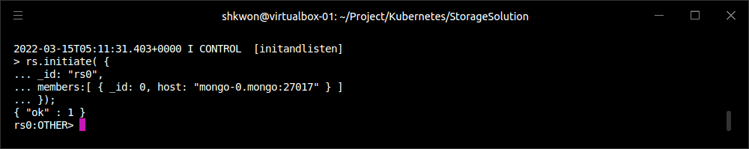
Kubernetes-Native Storage with StatefulSets(7/15)
Manually Replicated MongoDB with StatefulSets :
  Next, we’re going to manually set up Mongo replication using these per-Pod hostnames. We’ll choose “mongo-0.mongo” to be our initial primary. Run the mongo tool in that Pod :
  This command tells mongodb to initiate the ReplicaSet “rs0” with “mongo-0.mongo” as the primary replica.
  NOTE : The “rs0” name is arbitrary. You can use whatever you’d like, but you’ll need to change it in the “mongo-simple.yaml” StatefulSet definition as well.
$ kubectl exec -it mongo-0 mongo
> rs.initiate( {
_id: "rs0",
members:[ { _id: 0, host: "mongo-0.mongo:27017" } ]
});
OK

Slide 32
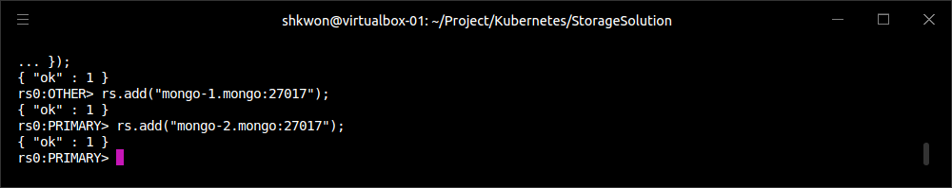
Kubernetes-Native Storage with StatefulSets(8/15)
Manually Replicated MongoDB with StatefulSets :
  Once you have initiated the Mongo ReplicaSet, you can add the remaining replicas by running the following commands in the mongo tool on the “mongo-0.mongo” Pod :
  As you can see, we are using the replica-specific DNS names to add them as replicas in our Mongo cluster. At this point, we’re done manually. Our replicated MongoDB is up and running.
  NOTE : To exit from the console, just type “exit” command. The terminal will show you “bye” message.
> rs.add("mongo-1.mongo:27017");
> rs.add("mongo-2.mongo:27017");

Slide 33
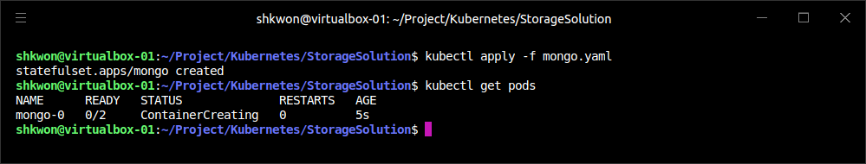
Kubernetes-Native Storage with StatefulSets(9/15)
Automating MongoDB Cluster Creation :
  To automate the deployment of our StatefulSet-based MongoDB cluster, we’re going to add an additional container to our Pods to perform the initialization.
  To configure this Pod without having to build a new Docker image, we’re going to use a “ConfigMap” to add a script into the existing MongoDB image. Here’s the container we’re adding :
...
- name: init-mongo
image: mongo:3.4.1
command:
- bash
- /config/init.sh
volumeMounts:
- name: config
mountPath: /config
volumes:
- name: config
configMap:
name: "mongo-init"
mongo.yaml

Slide 34
Kubernetes-Native Storage with StatefulSets(10/15)
Automating MongoDB Cluster Creation :
  Note that it is mounting a ConfigMap volume whose name is “mongo-init”. This ConfigMap holds a script that performs our initialization. First, the script determines whether it is running on “mongo-0” or not. If it is on “mongo-0”, it creates the ReplicaSet using the same command we ran imperatively previously. If it is on a different Mongo replica, it waits until the ReplicaSet exists, and then it registers itself as a member of that ReplicaSet.
apiVersion: v1
kind: ConfigMap
metadata:
name: mongo-init
data:
init.sh: |
#!/bin/bash
# Need to wait for the readiness health check to pass so that the
# mongo names resolve. This is kind of wonky.
until ping -c 1 ${HOSTNAME}.mongo; do
echo "waiting for DNS (${HOSTNAME}.mongo)..."
sleep 2
done
until /usr/bin/mongo --eval 'printjson(db.serverStatus())'; do
echo "connecting to local mongo..."
sleep 2
done
echo "connected to local."
HOST=mongo-0.mongo:27017
until /usr/bin/mongo --host=${HOST} --eval 'printjson(db.serverStatus())'; do
echo "connecting to remote mongo..."
sleep 2
done
echo "connected to remote."
if [[ "${HOSTNAME}" != 'mongo-0' ]]; then
until /usr/bin/mongo --host=${HOST} --eval="printjson(rs.status())" \
| grep -v "no replset config has been received"; do
echo "waiting for replication set initialization"
sleep 2
done
echo "adding self to mongo-0"
/usr/bin/mongo --host=${HOST} \
--eval="printjson(rs.add('${HOSTNAME}.mongo'))"
fi
if [[ "${HOSTNAME}" == 'mongo-0' ]]; then
echo "initializing replica set"
/usr/bin/mongo --eval="printjson(rs.initiate(\
{'_id': 'rs0', 'members': [{'_id': 0, \
'host': 'mongo-0.mongo:27017'}]}))"
fi
echo "initialized“
# Run forever.
while true; do
sleep 3600
done
mongo-configmap.yaml

Slide 35
Kubernetes-Native Storage with StatefulSets(11/15)
Automating MongoDB Cluster Creation :
  NOTE : The previous script currently sleeps forever after initializing the cluster. Every container in a Pod has to have the same RestartPolicy. Since we do not want our main Mongo container to be restarted, we need to have our initialization container run forever too, or else Kubernetes might think our Mongo Pod is unhealthy.
  Putting it all together, the following YAML file is the complete StatefulSet that uses the ConfigMap.
apiVersion: apps/v1
kind: StatefulSet
metadata:
name: mongo
spec:
selector:
matchLabels:
app: mongo
serviceName: "mongo"
replicas: 3
template:
metadata:
labels:
app: mongo
spec:
containers:
- name: mongodb
image: mongo:3.4.1
command:
- mongod
- --replSet
- rs0
ports:
- containerPort: 27017
name: web
# This container initializes the mongodb, then sleeps.
- name: init-mongo
image: mongo:3.4.1
command:
- bash
- /config/init.sh
volumeMounts:
- name: config
mountPath: /config
volumes:
- name: config
configMap:
name: "mongo-init“
mongo.yaml

Slide 36
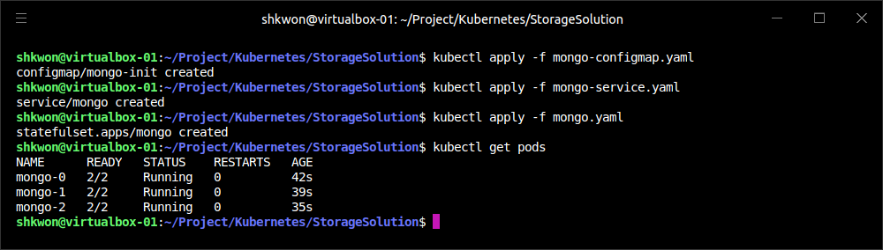
Kubernetes-Native Storage with StatefulSets(12/15)
Automating MongoDB Cluster Creation :
  Given all of these files, you can create a Mongo cluster with :
  NOTE : You can combine them all into a single YAML file where the individual objects are separated by “---”.
  NOTE : Ensure that you keep the same ordering(“kubectl apply -f xxx”), since “the StatefulSet definition relies on the ConfigMap definition existing”.
$ kubectl apply -f mongo-configmap.yaml
$ kubectl apply -f mongo-service.yaml
$ kubectl apply -f mongo.yaml

Slide 37
Kubernetes-Native Storage with StatefulSets(13/15)
Persistent Volumes and StatefulSets :
  For persistent storage, you need to mount a persistent volume into the “/data/db” directory. In the Pod template, you need to update it to mount a persistent volume claim to that directory :
  While this approach is similar to the one we saw with reliable singletons, because the StatefulSet replicates more than one Pod you cannot simply reference a persistent volume claim. Instead, you need to add a “persistent volume claim template”. You can think of the claim template as being identical to the Pod template, but instead of creating Pods, it creates volume claims. You need to add the following onto the bottom of your StatefulSet definition :
...
volumeMounts:
- name: database
mountPath: /data/db
volumeClaimTemplates:
- metadata:
name: database
annotations:
volume.alpha.kubernetes.io/storage-class: anything
spec:
accessModes: [ "ReadWriteOnce" ]
resources:
requests:
storage: 100Gi

Slide 38
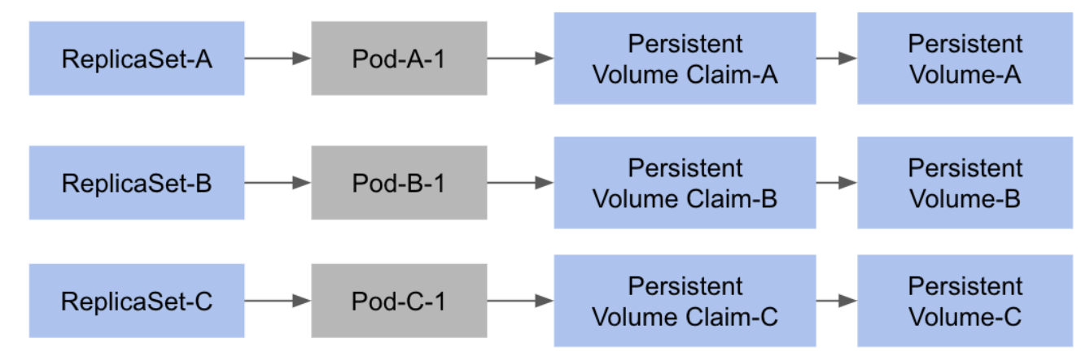
Kubernetes-Native Storage with StatefulSets(14/15)
Persistent Volumes and StatefulSets :
  When you add a volume claim template to a StatefulSet definition, each time the StatefulSet controller creates a Pod that is part of the StatefulSet it will create a persistent volume claim based on this template as part of that Pod.
  NOTE : In order for these replicated persistent volumes to work correctly, you either need to have “autoprovisioning” set up for persistent volumes, or you need to prepopulate a collection of persistent volume objects for the StatefulSet controller to draw from. If there are no claims that can be created, the StatefulSet controller will not be able to create the corresponding Pods.

Slide 39
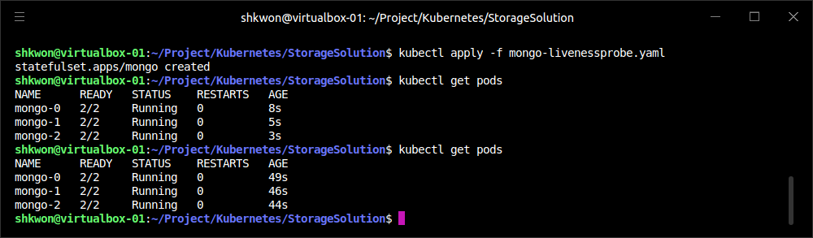
Kubernetes-Native Storage with StatefulSets(15/15)
One Final Thing: Readiness Probes :
  The final piece in productionizing our MongoDB cluster is to add liveness checks to our Mongo-serving containers. The liveness probe is used to determine if a container is operating correctly. For the liveness checks, we can use the “mongo tool“ itself by adding the following to the Pod template in the StatefulSet object :
...
livenessProbe:
exec:
command:
- /usr/bin/mongo
- --eval
- db.serverStatus()
initialDelaySeconds: 10
timeoutSeconds: 10
...
mongo-livenessprobe.yaml
NOTE : Run “kubectl delete -f mongo.yaml” first.

Slide 40
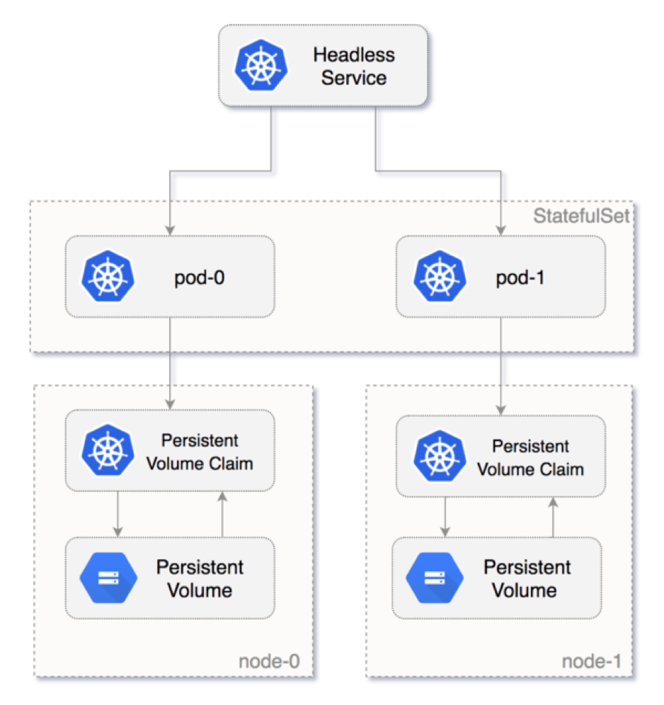
NOTE : Summary
Remember :
  Once we have combined StatefulSets, persistent volume claims, and liveness probing, we have a hardened, scalable cloud-native MongoDB installation running on Kubernetes.
  While the example dealt with MongoDB, the steps for creating StatefulSets to manage other storage solutions are quite similar and similar patterns can be followed.

Slide 41
Extending Kubernetes

Slide 42
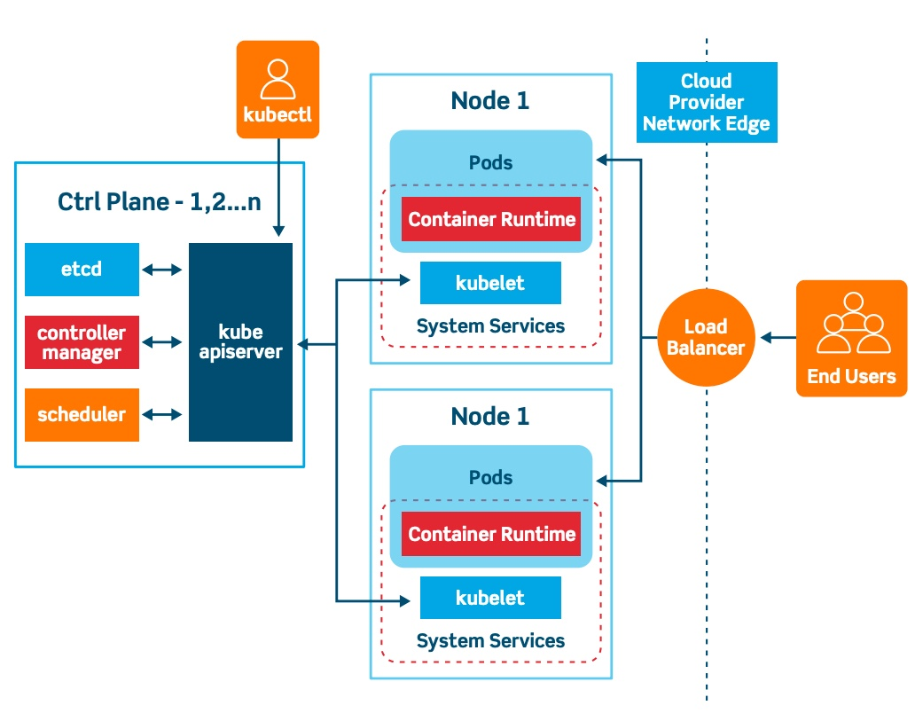
Introduction
Extensible Kubernetes API Server :
  Kubernetes was going to be more than its core set of APIs; once an application is orchestrated within the cluster, there are countless other useful tools and utilities that can be represented and deployed as API objects in the Kubernetes cluster. The challenge was how to embrace this explosion of objects and use cases without having an API that sprawled without bound.
  To resolve this tension between extended use cases and API sprawl, significant effort was put into making the Kubernetes API extensible. This extensibility meant that cluster operators could customize their clusters with the additional components that suited their needs. This extensibility enables people to augment their clusters themselves, consume community-developed cluster add-ons, and even develop extensions that are bundled and sold in an ecosystem of cluster plug-ins. Extensibility has also given rise to whole new patterns of managing systems, such as the operator pattern.
  Regardless of whether you are building your own extensions or consuming operators from the ecosystem, understanding how the Kubernetes API server is extended and how extensions can be built and delivered is a key component to unlocking the complete power of Kubernetes and its ecosystem. As more and more advanced tools and platforms are built on top of Kubernetes using these extensibility mechanisms, a working knowledge of how they operate is critical.

Slide 43
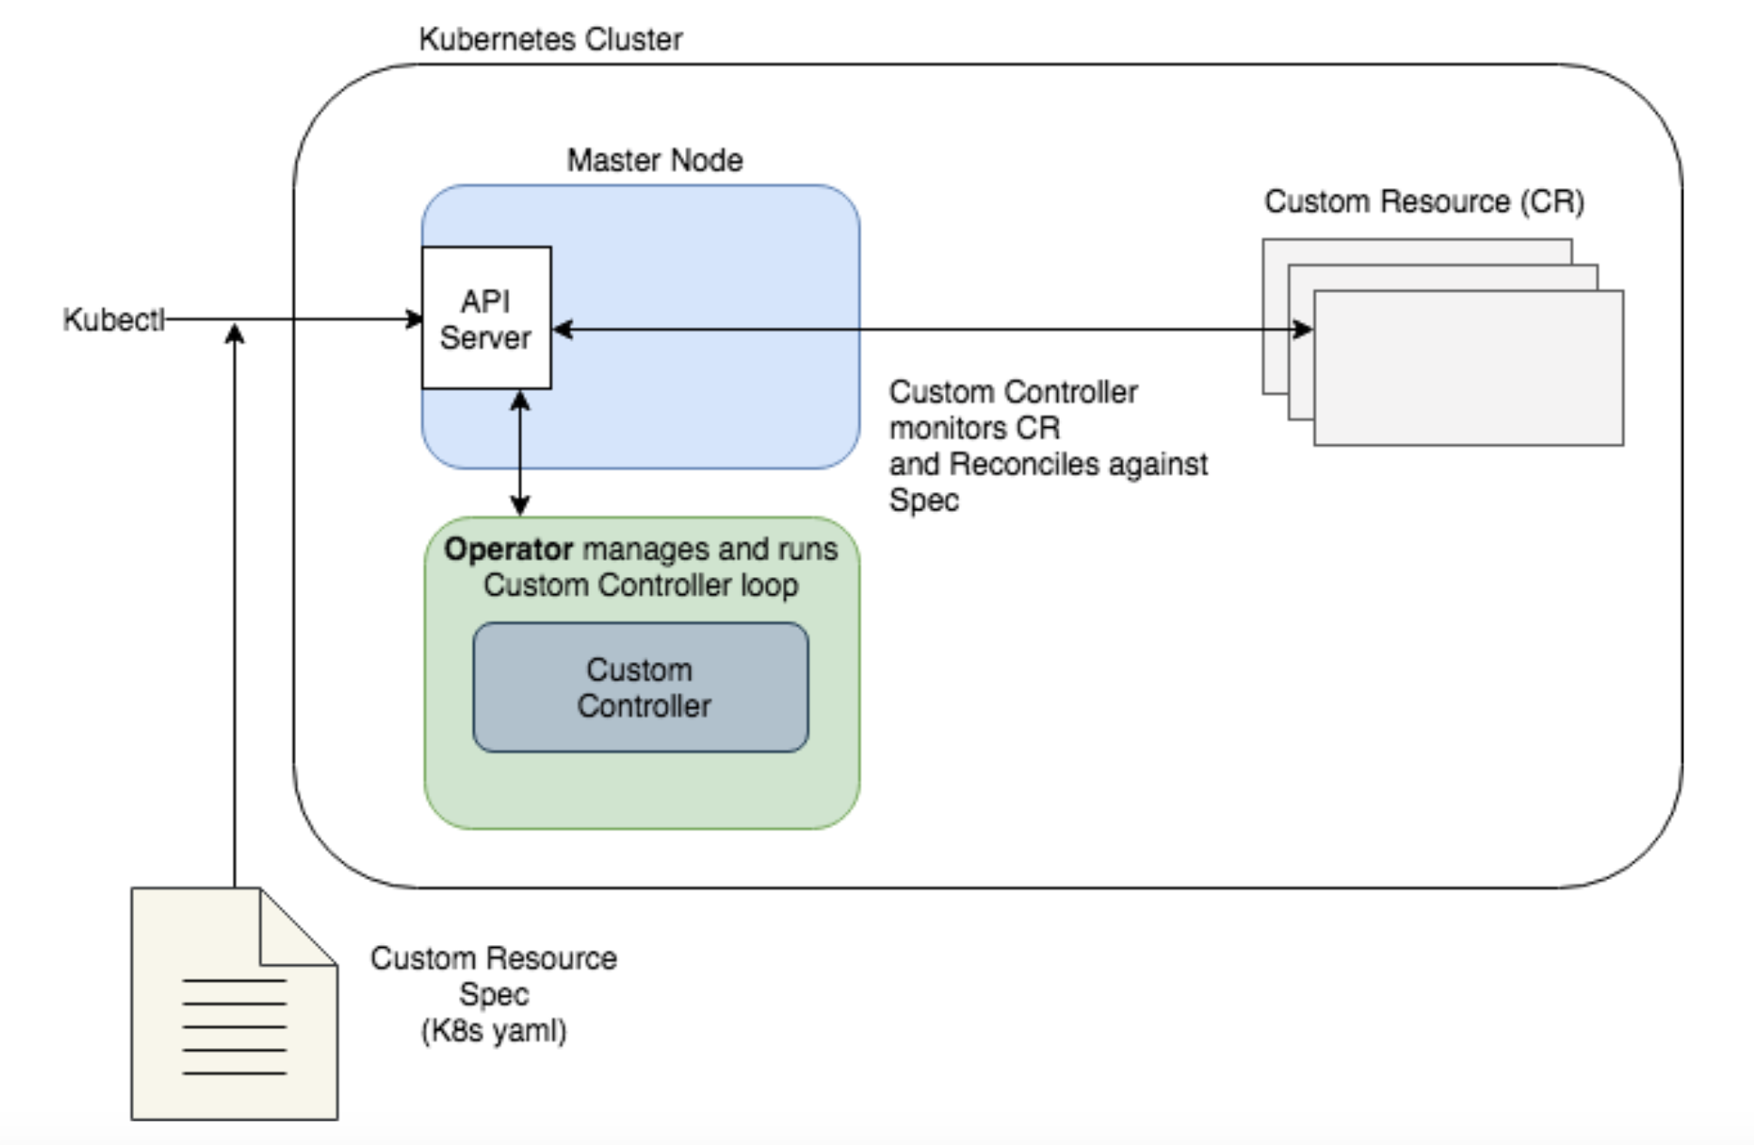
What It Means to Extend Kubernetes
Extending the Kubernetes API :
  In general, extensions to the Kubernetes API server either add new functionality to a cluster or limit and tweak the ways that users can interact with their clusters. There is a rich ecosystem of plug-ins that cluster administrators can use to add additional services and capabilities to their clusters.
  It’s worth noting that extending the cluster is a very high-privilege thing to do. It is not a capability that should be extended to arbitrary users or arbitrary code, because cluster administrator privileges are required to extend a cluster. Even cluster administrators should be careful and use diligence when installing third-party tools. Some extensions, like admission controllers, can be used to view all objects being created in the cluster, and could easily be used as a vector to steal secrets or run malicious code.
  Additionally, extending a cluster makes it different than stock Kubernetes. When running on multiple clusters, it is very valuable to build tooling to maintain consistency of experience across the clusters, and this includes the extensions that are installed.

Slide 44
Points of Extensibility(1/18)
The API Server :
  There are many different ways to extend Kubernetes, from “CustomResourceDefinitions” through to “Container Network Interface (CNI)” plug-ins. We are going to focus on the extensions to the API server via adding new resource types or admission controllers to API requests. We will not cover the CNI/CSI/CRI (Container Network Interface/Container Storage Interface/Container Runtime Interface) extensions, as they are more commonly used by Kubernetes cluster providers as opposed to the end users of Kubernetes.
  In addition to admission controllers and API extensions, there are actually a number of ways to “extend” your cluster without ever modifying the API server at all. These include “DaemonSets” that install automatic logging and monitoring, tools that scan your services for cross-site scripting (XSS) vulnerabilities, and more.
The role of admission controllers and CustomResourceDefinitions - The flow of requests through the Kubernetes API server

Slide 45
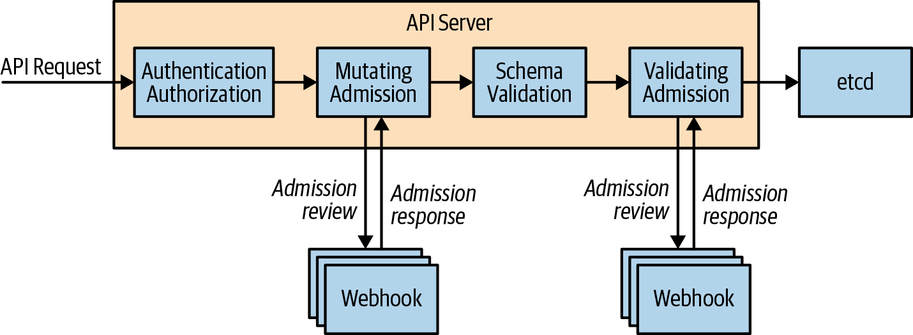
Points of Extensibility(2/18)
Admission Controllers :
  “Admission controllers” are called prior to the API object being written into the backing storage. Admission controllers can reject or modify API requests. There are several admission controllers that are built into the Kubernetes API server; for example, the limit range admission controller that sets default limits for Pods without them. Many other systems use custom admission controllers to “auto-inject sidecar” containers into all Pods created on the system to enable “auto-magic” experiences.
Admission Controller

Slide 46
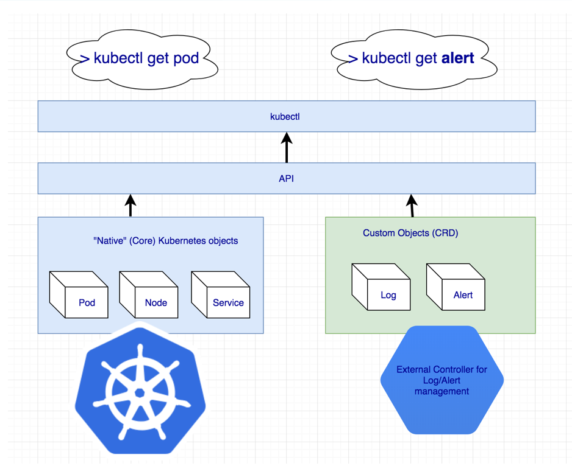
Points of Extensibility(3/18)
Custom Resources :
  The other form of extension, which can also be used in conjunction with admission controllers, is custom resources. With custom resources, whole new API objects are added to the Kubernetes API surface area. These new API objects can be added to namespaces, are subject to RBAC, and can be accessed with existing tools like kubectl as well as via the Kubernetes API.
  The first thing that you do to create a custom resource is to create a “CustomResourceDefinition”. This object is actually a meta-resource; that is, a resource that is the definition of another resource. As a concrete example, consider defining a new resource to represent load tests in your cluster. When a new “LoadTest” resource is created, a load test is spun up in your Kubernetes cluster and drives traffic to a service.

Slide 47
Points of Extensibility(4/18)
Custom Resource Definition :
  The first step in creating this new resource is defining it through a CustomResourceDefinition. An example definition looks as follows :
  The “CustomResourceDefinition” has a metadata subobject, and within that subobject the resource is named. However, in the case of custom resources, the name is special. It has to be the following format : “<resourceplural>.<api-group>”(“loadtests.beta.kuar.com”). The reason for this is to ensure that each resource definition is unique in the cluster, because the name of each CustomResourceDefinition has to match this pattern, and no two objects in the cluster can have the same name. We are thus guaranteed that no two CustomResourceDefinitions define the same resource.
apiVersion: apiextensions.k8s.io/v1
kind: CustomResourceDefinition
metadata:
name: loadtests.beta.kuar.com
spec:
group: beta.kuar.com
versions:
- name: v1
served: true
storage: true
schema:
openAPIV3Schema:
type: object
scope: Namespaced
names:
plural: loadtests
singular: loadtest
kind: LoadTest
shortNames:
- lt
loadtest-resource.yaml

Slide 48
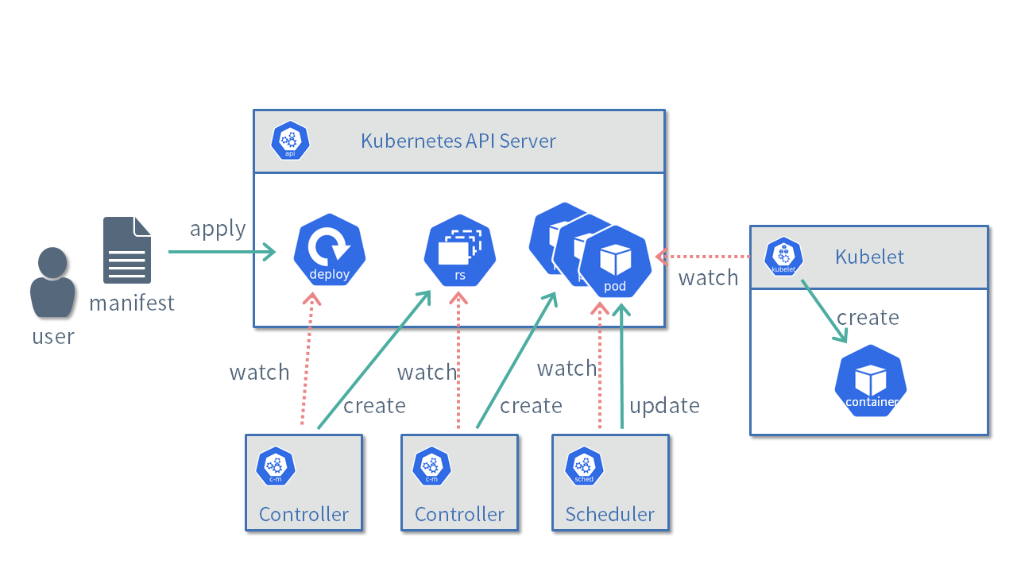
Points of Extensibility(5/18)
Custom Resource Definition :
  The CustomResourceDefinition has a spec subobject. This is where the resource itself is defined. In that spec object, there is an apigroup(“beta.kuar.com”) field which supplies the API group for the resource. As mentioned previously, it must match the suffix of the CustomResourceDefinition’s name.
  There is a list of versions for the resource(“versions”). In addition to the name of the version (e.g., v1, v2, etc.), there are fields that indicate if that version is served by the API server and which version is used for storing data in the backing storage for the API server. The storage field must be true for only a single version for the resource.
  There is also a scope field to indicate if the resource is namespaced or not (the default is namespaced), and a names field that allows for the definition of the singular, plural, and kind values for the resource. It also allows the definition of convenience “short names” for the resource for use in kubectl and elsewhere.

Slide 49
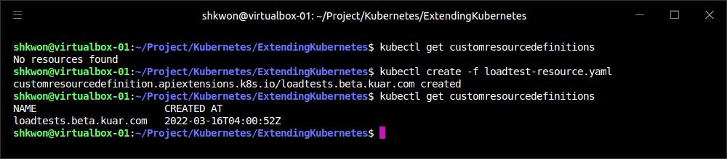
Points of Extensibility(6/18)
Custom Resource Definition :
  Given this definition, you can create the resource in the Kubernetes API server. But first, to show the true nature of dynamic resource types, try to list our “loadtests” resource using “kubectl get” command :
  Now use “loadtest-resource.yaml” to create this resource :
  After you run “kubectl create -f loadtest-resource.yaml” command, there is a “LoadTest” resource type defined. Though there are still no instances of this resource type.
$ kubectl get customresourcedefinitions
$ kubectl create -f loadtest-resource.yaml

Slide 50
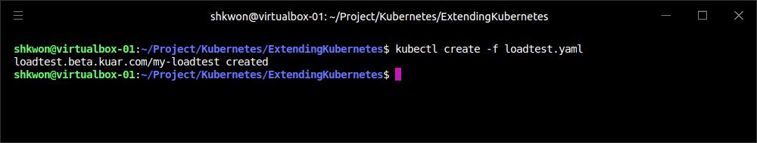
Points of Extensibility(7/18)
Custom Resource Definition :
  As with all built-in Kubernetes API objects, you can use YAML or JSON to define a custom resource (in this case our LoadTest). See the following definition.
  You can now use this “loadtest.yaml” file to create a resource just like you would with any built-in type :
apiVersion: beta.kuar.com/v1
kind: LoadTest
metadata:
name: my-loadtest
spec:
service: my-service
scheme: https
requestsPerSecond: 1000
paths:
- /index.html
- /login.html
- /shares/my-shares/
loadtest.yaml
$ kubectl create -f loadtest.yaml

Slide 51
NOTE : Using Custom Resource Definition
Spec Definition :
  You need to add the following lines to “loadtest-resource.yaml” file. In your “loadtest.yaml” file, you used “spec” field to define the method accessing the resource. So you also need to modify the “loadtest-resource.yaml” file according to the “spec” field in “loadtest.yaml” file.
apiVersion: apiextensions.k8s.io/v1
kind: CustomResourceDefinition
metadata:
name: loadtests.beta.kuar.com
spec:
group: beta.kuar.com
versions:
- name: v1
served: true
storage: true
schema:
openAPIV3Schema:
type: object
properties:
spec:
type: object
properties:
service:
type: string
scheme:
type: string
requestsPerSecond:
type: integer
paths:
type: array
items:
type: string
scope: Namespaced
names:
plural: loadtests
singular: loadtest
kind: LoadTest
shortNames:
- lt

Slide 52
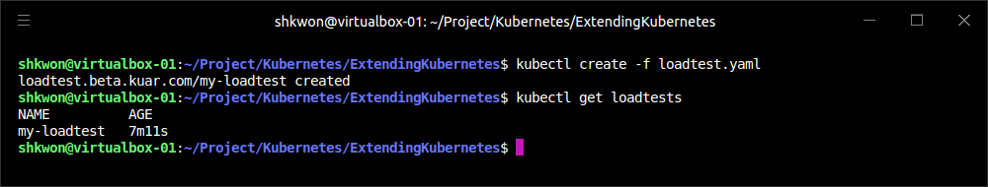
Points of Extensibility(8/18)
Custom Resource Definition :
  Now when you list the “loadtests” resource, you’ll see your newly created resource :
  This may be exciting, but it doesn’t really do anything yet. Sure, you can use this simple CRUD (Create/Read/Update/Delete) API to manipulate the data for “LoadTest” objects, but no actual load tests are created in response to this new API we defined.
  This is because there is no controller present in the cluster to react and take action when a “LoadTest” object is defined. The “LoadTest” custom resource is only half of the infrastructure needed to add “LoadTests” to our cluster. The other is a piece of code that will continuously monitor the custom resources and create, modify, or delete LoadTests as necessary to implement the API.
$ kubectl get loadtests

Slide 53
Points of Extensibility(9/18)
Custom Resource Definition :
  Just like the user of the API, the controller interacts with the API server to list “LoadTests” and watches for any changes that might occur. This interaction between controller and API server is shown in the following figure.
  The code for such a controller can range from simple to complex. The simplest controllers run a for loop and repeatedly poll for new custom objects, and then take actions to create or delete the resources that implement those custom objects (e.g., the LoadTest worker pods).
  The polling-based approach is inefficient: the period of the polling loop adds unnecessary latency, and the overhead of polling may add unnecessary load on the API server. A more efficient approach is to use the watch API on the API server, which provides a stream of updates when they occur, eliminating both the latency and overhead of polling. However, using this API correctly in a bug-free way is complicated. As a result, if you want to use watches, it is highly recommended that you use a well-supported mechanism such as the “Informer pattern” exposed in the client-go library.

Slide 54
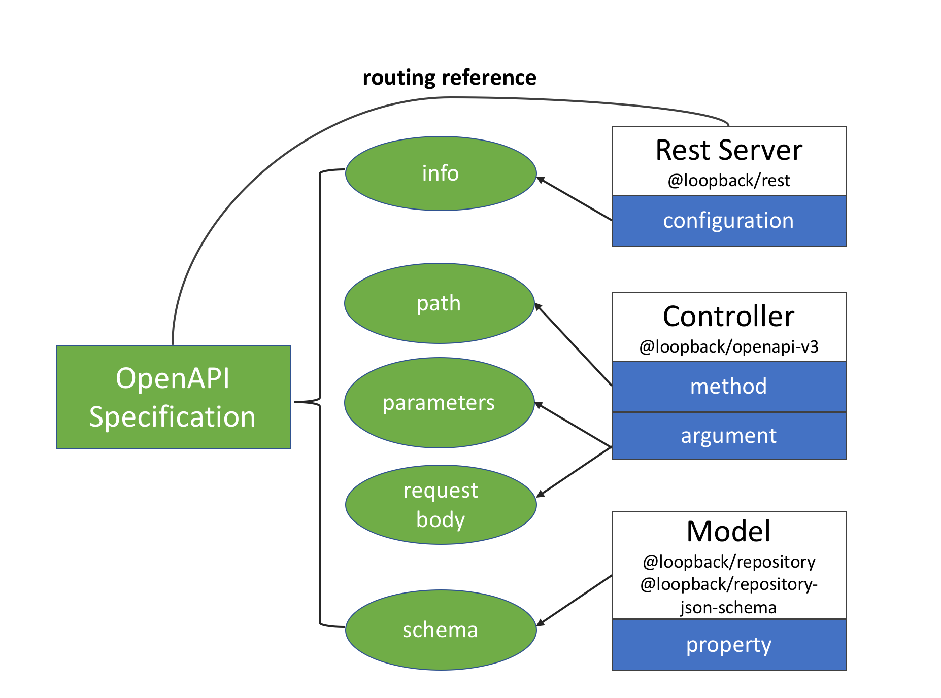
Points of Extensibility(10/18)
Custom Resource Definition :
  Now we have the basic functionality of a new resource in our cluster. However, many parts of what it means to be a well-functioning resource are missing. The two most important are validation and defaulting. Validation is the process of ensuring that “LoadTest” objects sent to the API server are well formed and can be used to create load tests, while defaulting makes it easier for people to use our resources by providing automatic, commonly used values by default.
  One option for adding validation is via an OpenAPI specification(“openAPIV3Schema”) for our objects. This can be useful for basic validation of the presence of required fields or the absence of unknown fields.
  Generally speaking, an API schema is actually insufficient for validation of API objects. For example, in our “loadtests” example, we may want to validate that the “LoadTest” object has a valid scheme (e.g., http or https) or that “requestsPerSecond” is a nonzero positive number.

Slide 55
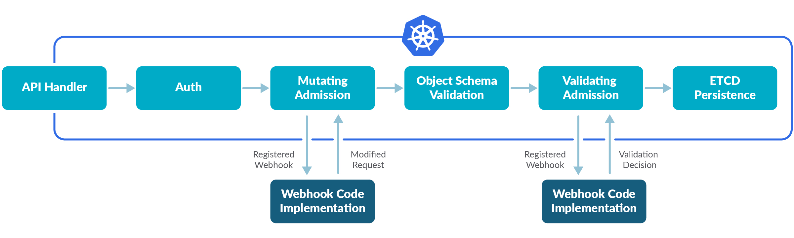
Points of Extensibility(11/18)
Custom Resource Definition :
  To accomplish more reliable validation, we will use a “validating admission controller”. As discussed previously, admission controllers intercept requests to the API server before they are processed and can reject or modify the requests in flight.
  Admission controllers can be added to a cluster via the “dynamic admission control system”. A dynamic admission controller is a simple HTTP application. The API server connects to the admission controller via either a Kubernetes Service object or an arbitrary URL. This means that admission controllers can optionally run outside of the cluster—for example, in a cloud provider’s “Function-as-a-Service” offering, like Azure Functions or AWS Lambda.

Slide 56
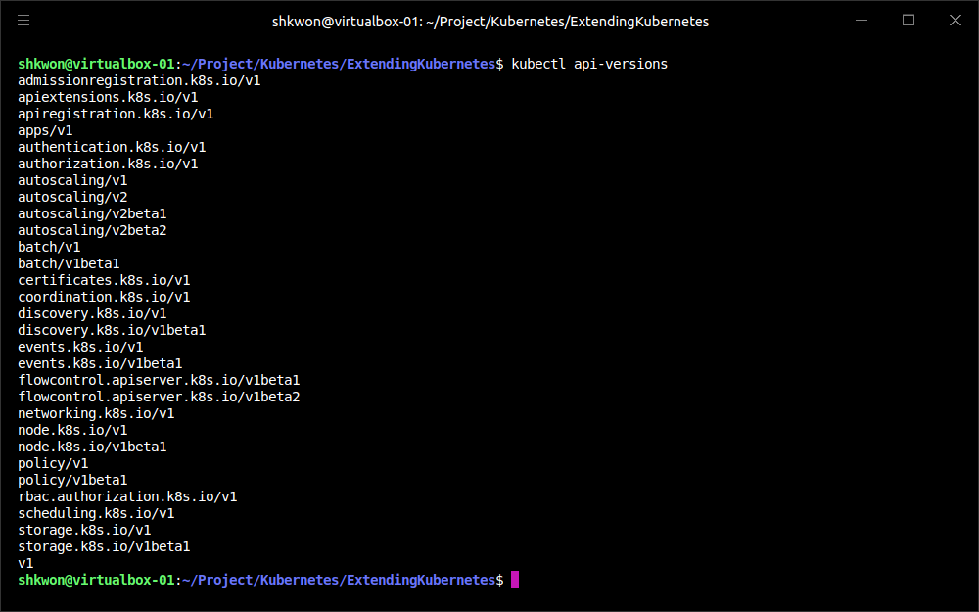
NOTE : Kubernetes API Versions
Supported Kubernetes APIs :
  You can check which version and what kind of APIs are supported in your Kubernetes API server using the following command.
$ kubectl api-versions

Slide 57
Points of Extensibility(12/18)
Custom Resource Definition :
  To install our validating admission controller, we need to specify it as a Kubernetes “ValidatingWebhookConfiguration”. This object specifies the endpoint where the admission controller runs, as well as the resource (in this case “LoadTest”) and the action (in this case “CREATE”) where the admission controller should be run. You can see the full definition for the validating admission controller in the following code :
  NOTICE!!! - In “caBundle”, you need to add your “~/minikube/ca.crt” file contents between “begin” and “end” delimiters. If you do not add, you will get “ValidatingWebhookConfiguration in version ‘v1’ cannot be handled as a ValidatingWebhookConfiguration: illegal base64 data at input byte 8” error message when you run “kubectl create -f” command using this YAML file.
apiVersion: admissionregistration.k8s.io/v1
kind: ValidatingWebhookConfiguration
metadata:
name: "kuar-validator"
webhooks:
- name: "validator.kuar.com"
rules:
- apiGroups: ["beta.kuar.com"]
apiVersions: ["v1"]
operations: ["CREATE"]
resources: ["loadtests"]
scope: "Namespaced"
clientConfig:
# Substitute the appropriate IP address for your webhook
url: https://localhost:8080
# This should be the base64-encoded CA certificate for your cluster,
# you can find it in your ${KUBECONFIG} file
caBundle: “<Copy and paste the “~/.minikube/ca.crt” file contents here.>”
admissionReviewVersions: ["v1"]
sideEffects: None

Slide 58
NOTE : Client Configuration in Webhook
URL in “clientConfig” :
  “url” gives the location of the webhook, in standard URL form (scheme://host:port/path). Exactly one of “url” or service must be specified. The host should not refer to a service running in the cluster; use the “service” field instead. The “host” might be resolved via external DNS in some “apiservers” (e.g., “kube-apiserver” cannot resolve in-cluster DNS as that would be a layering violation). “host” may also be an IP address.
  Please note that using “localhost” or “127.0.0.1” as a host is risky unless you take great care to run this webhook on all hosts which run an “apiserver” which might need to make calls to this webhook. Such installs are likely to be non-portable, i.e., not easy to turn up in a new cluster.
  Please refer to https://www.pulumi.com/registry/packages/kubernetes/api-docs/admissionregistration/v1/validatingwebhookconfiguration/#webhookclientconfig for more information.

Slide 59
Points of Extensibility(13/18)
Custom Resource Definition :
  Fortunately for security, but unfortunately for complexity, webhooks that are accessed by the Kubernetes API server can only be accessed via HTTPS. This means that we need to generate a certificate to serve the webhook. The easiest way to do this is to use the cluster’s ability to generate new certificates using its own certificate authority (CA).
  To access the webhook, we need a private key and a certificate signing request (CSR)-X509.
package main
import (
"crypto/rand"
"crypto/rsa"
"crypto/x509"
"crypto/x509/pkix"
"encoding/asn1"
"encoding/pem"
"net/url"
"os"
)
func main() {
host := os.Args[1]
name := "server"
key, err := rsa.GenerateKey(rand.Reader, 1024)
if err != nil {
panic(err)
}
keyDer := x509.MarshalPKCS1PrivateKey(key)
keyBlock := pem.Block{
Type: "RSA PRIVATE KEY",
Bytes: keyDer,
}
keyFile, err := os.Create(name + ".key")
if err != nil {
panic(err)
}
pem.Encode(keyFile, &keyBlock)
keyFile.Close()
commonName := "myuser"
emailAddress := "someone@myco.com"
org := "My Co, Inc."
orgUnit := "Widget Farmers"
city := "Seattle"
state := "WA"
country := "US"
subject := pkix.Name{
CommonName: commonName,
Country: []string{country},
Locality: []string{city},
Organization: []string{org},
OrganizationalUnit: []string{orgUnit},
Province: []string{state},
}
uri, err := url.ParseRequestURI(host)
if err != nil {
panic(err)
}
asn1, err := asn1.Marshal(subject.ToRDNSequence())
if err != nil {
panic(err)
}
csr := x509.CertificateRequest{
RawSubject: asn1,
EmailAddresses: []string{emailAddress},
SignatureAlgorithm: x509.SHA256WithRSA,
URIs: []*url.URL{uri},
}
bytes, err := x509.CreateCertificateRequest(rand.Reader, &csr, key)
if err != nil {
panic(err)
}
csrFile, err := os.Create(name + ".csr")
if err != nil {
panic(err)
}
pem.Encode(csrFile, &pem.Block{Type: "CERTIFICATE REQUEST", Bytes: bytes})
csrFile.Close()
}

Slide 60
Points of Extensibility(14/18)
Custom Resource Definition :
  You can run the Golang program with the following command. And it will generate two files, “server.csr” and “server-key.pem”.
  You can then create a certificate signing request for the Kubernetes API server using the following YAML :
  NOTICE!!! For the request field the value of “REPLACEME” needs to be replaced with the base64-encoded certificate signing request we produced in the preceding code :
  NOTE : “perl” will take the input file(“admission-controller-csr.yaml”) and replace “REPLACEME” with the base64 encoded part of “server.csr” file.
$ go run csr-gen.go <URL-for-webook>
apiVersion: certificates.k8s.io/v1
kind: CertificateSigningRequest
metadata:
name: validating-controller.default
spec:
groups:
- system:authenticated
request: REPLACEME
signerName: kubernetes.io/kube-apiserver-client
usages:
- digital signature
- key encipherment
- key agreement
$ perl -pi -e s/REPLACEME/$(base64 server.csr | tr -d '\n')/ admission-controller-csr.yaml

Slide 61
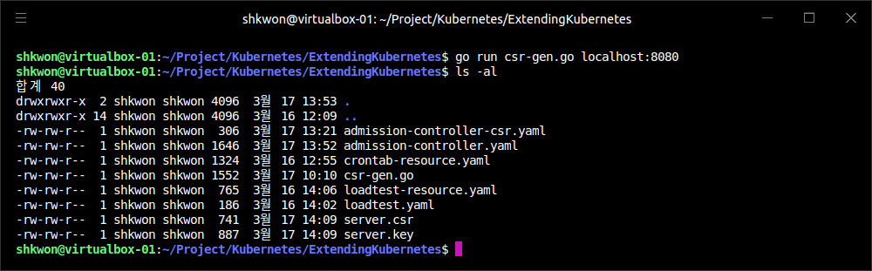
NOTE : Running Golang CSR Program
The Result :
  When you run the previous command to get the server CSR and PEM files, you will see the following screenshot.
$ go run csr-gen.go localhost:8080

Slide 62
NOTE : Installing Golang
Golang Programming :
  To install the Golang programming language, you need to see : https://go.dev/dl/. There are installation methods for Windows, Linux and MacOS. For Linux you can follow the next steps.
  Step 01. Download the Golang executable image for Linux.
  Step 02. Extract the archive you downloaded into “/usr/local”, creating a Go tree in “/usr/local/go”. Important: This step will remove a previous installation at “/usr/local/go”, if any, prior to extracting. Please back up any data before proceeding. For example, run the following as root or through sudo :
  Step 03. Add “/usr/local/go/bin” to the “PATH” environment variable. You can do this by adding the following line to your “$HOME/.profile” or “/etc/profile” (for a system-wide installation) :
    Note: Changes made to a profile file may not apply until the next time you log into your computer. To apply the changes immediately, just run the shell commands directly or execute them from the profile using a command such as “source $HOME/.profile”. For “GOPATH” and “GOBIN”, you need to create a directory in your “$HOME” with “mkdir $HOME/Go” command. The “Visual Studio Code” and Other tools like “Atom” will use these environment variables.
  Step 04. Verify that you've installed Go by opening a command prompt and typing the following command :
$ sudo rm -rf /usr/local/go && tar -C /usr/local -xzf go1.18.linux-amd64.tar.gz
export PATH=$PATH:/usr/local/go/bin
export GOROOT=/usr/local/go
export GOPATH=$HOME/Go
export GOBIN=$HOME/Go/bin
$ go version

Slide 63
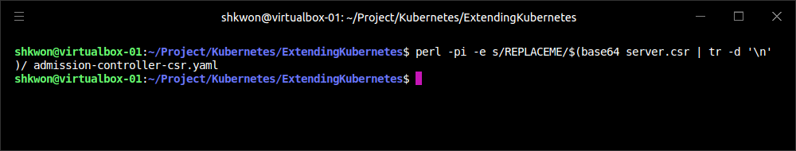
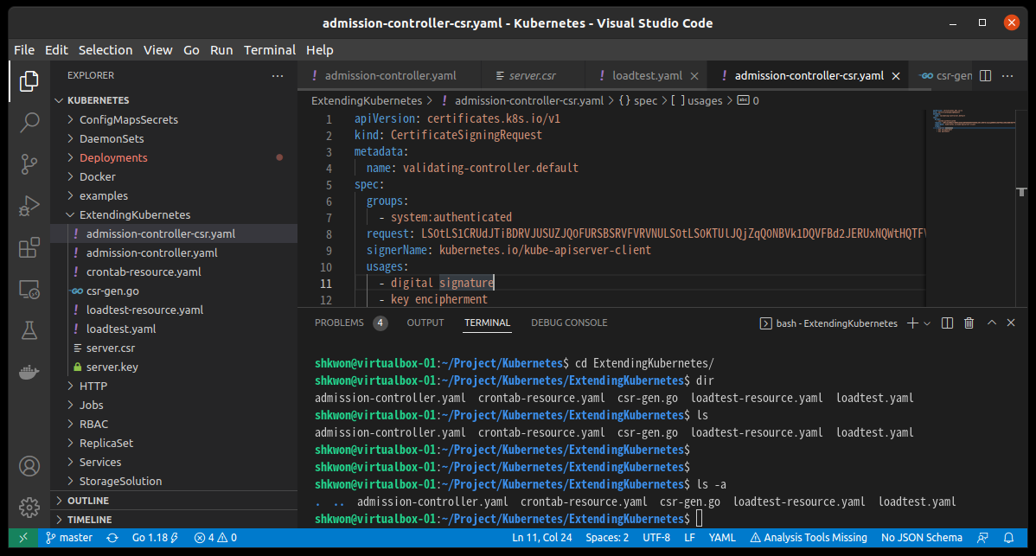
Points of Extensibility(15/18)
Custom Resource Definition :
  Run the previous command and you will get the following screenshot.
$ perl -pi -e s/REPLACEME/$(base64 server.csr | tr -d '\n')/ admission-controller-csr.yaml

Slide 64
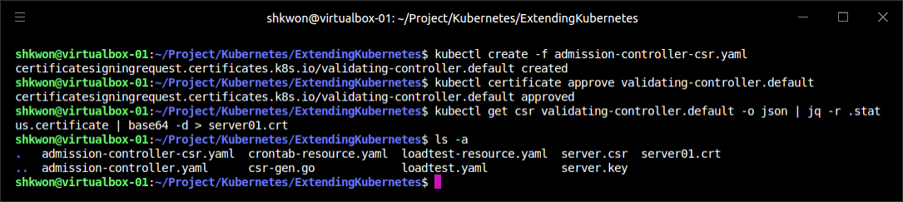
Points of Extensibility(16/18)
Custom Resource Definition :
  Now that your certificate signing request is ready, you can send it to the API server to get the certificate :
  Next, you need to approve that request :
  Once approved, you can download the new certificate :
  NOTE : Before you run the final command, you need to install “jq”. Use “sudo apt install jq” command. I changed “server.crt” to “server01.crt” to see the result from the commands. You can also check other command results before “filters” in the command line.
$ kubectl create -f admission-controller-csr.yaml
$ kubectl certificate approve validating-controller.default
$ kubectl get csr validating-controller.default -o json | jq -r .status.certificate | base64 -d > server01.crt

Slide 65
Points of Extensibility(17/18)
Custom Resource Definition :
  With the certificate, you are finally ready to create an SSL-based admission controller. When the admission controller code receives a request, it contains an object of type “AdmissionReview”, which contains metadata about the request as well as the body of the request itself. In our validating admission controller we have only registered for a single resource type and a single action (CREATE), so we don’t need to examine the request metadata. Instead, we dive directly into the resource itself and validate that “requestsPerSecond” is positive and the “URL scheme” is valid. If they aren’t, we return a JSON body disallowing the request.
  Implementing an admission controller to provide defaulting is similar to the steps just described, but instead of using a “ValidatingWebhookConfiguration” you use a “MutatingWebhookConfiguration”, and you need to provide a JSONPatch object to mutate the request object before it is stored.

Slide 66
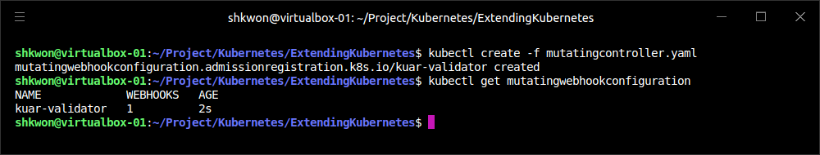
Points of Extensibility(18/18)
Custom Resource Definition :
  Here’s a “TypeScript” snippet that you can add to your validating admission controller to add defaulting. If the paths field in the “loadtest” is of length zero, add a single path for “/index.html” :
  You can then register this webhook as a “MutatingWebhookConfiguration” by simply changing the “kind” field in the YAML object and saving the file as “mutatingcontroller.yaml”. Then create the controller by running :
if (needsPatch(loadtest)) {
const patch = [
{ 'op': 'add', 'path': '/spec/paths', 'value': ['/index.html'] },
]
response['patch'] = Buffer.from(JSON.stringify(patch)).toString('base64’);
response['patchType'] = 'JSONPatch';
}
$ kubectl create -f mutating-controller.yaml

Slide 67
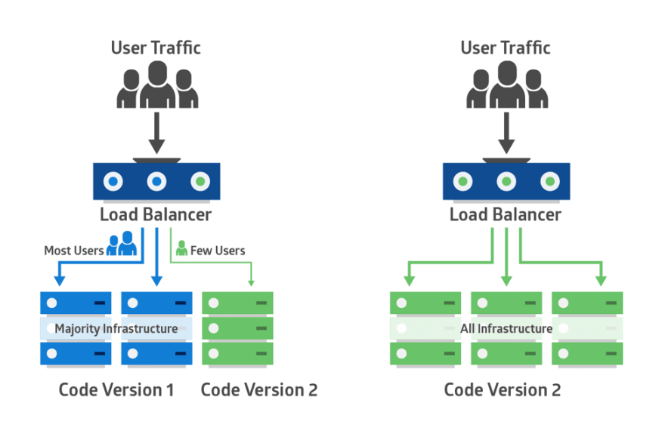
Patterns for Custom Resources(1/4)
Just Data :
  The easiest pattern for API extension is the notion of “just data.” In this pattern, you are simply using the API server for storage and retrieval of information for your application.
  Note that you should not use the Kubernetes API server for application data storage. The Kubernetes API server is not designed to be a key/value store for your app; instead, API extensions should be control or configuration objects that help you manage the deployment or runtime of your application. An example use case for the “just data” pattern might be “configuration for “canary deployments” of your application”—for example, directing 10% of all traffic to an experimental backend. While in theory such configuration information could also be stored in a ConfigMap, ConfigMaps are essentially untyped, and sometimes using a more strongly typed API extension object provides clarity and ease of use.
  Extensions that are just data don’t need a corresponding controller to activate them, but they may have validating or mutating admission controllers to ensure that they are well formed. For example, in the canary use case a validating controller might ensure that all percentages in the canary object sum to 100%.
Canary deployment

Slide 68
Patterns for Custom Resources(2/4)
Compilers :
  A slightly more complicated pattern is the “compiler” or “abstraction” pattern. In this pattern the API extension object represents a higher-level abstraction that is “compiled” into a combination of lower-level Kubernetes objects. The “LoadTest” extension in the previous example is an example of this compiler abstraction pattern.
  A user consumes the extension as a high-level concept, in this case a “loadtest”, but it comes into being by being deployed as a collection of Kubernetes Pods and services. To achieve this, a compiled abstraction requires an API controller to be running somewhere in the cluster, to watch the current “LoadTests” and create the “compiled” representation (and likewise delete representations that no longer exist). In contrast to the operator pattern described next, however, there is no online health maintenance for compiled abstractions; it is delegated down to the lower-level objects (e.g., Pods).
Abstraction

Slide 69
Patterns for Custom Resources(3/4)
Operators :
  The “operator” pattern provides online, proactive management of the resources created by the extensions. These extensions likely provide a higher-level abstraction (for example, a database) that is compiled down to a lower-level representation, but they also provide online functionality, such as “snapshot backups of the database”, or “upgrade notifications” when a new version of the software is available.
  To achieve this, the controller not only monitors the extension API to add or remove things as necessary, but also monitors the running state of the application supplied by the extension (e.g., a database) and takes actions to remediate unhealthy databases, take snapshots, or restore from a snapshot if a failure occurs. Operators are the most complicated pattern for API extension of Kubernetes, but they are also the most powerful, enabling users to get easy access to “self-driving” abstractions that are responsible not just for deployment, but also health checking and repair.

Slide 70
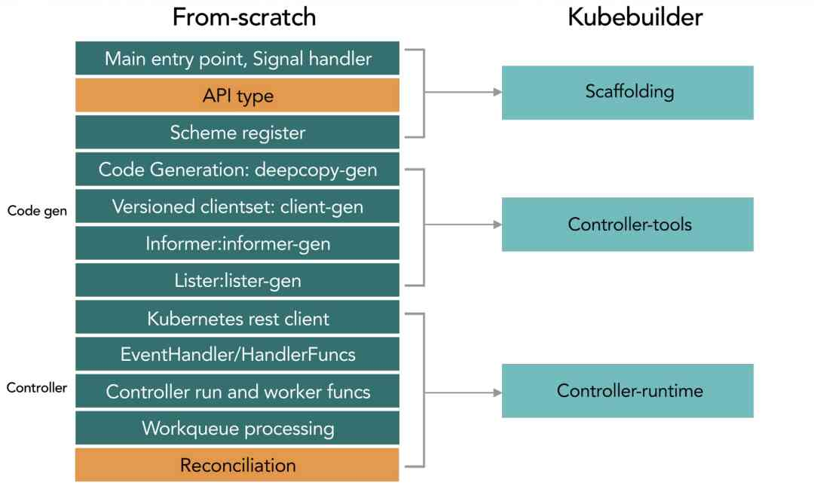
Patterns for Custom Resources(4/4)
Getting Started :
  The Kubebuilder project contains a library of code intended help you easily build reliable Kubernetes API extensions. It’s a great resource to help you bootstrap your extension.

Slide 71
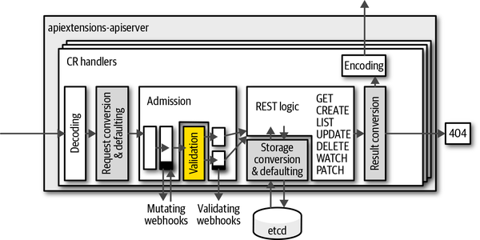
NOTE : Summary
Remember :
  One of the great “superpowers” of Kubernetes is its ecosystem, and one of the most significant things powering this ecosystem is the extensibility of the Kubernetes API. Whether you’re designing your own extensions to customize your cluster or consuming off-the-shelf extensions as utilities, cluster services, or operators, API extensions are the key to making your cluster your own and building the right environment for the rapid development of reliable applications.
  TODO : In our example, TLS validation has a problem that it does not return “status.certificates” field in response.

Slide 72
Deploying Real-World Applications

Slide 73

Jupyter(1/6)
Web-based Interactive Scientific Notebook :
  The Jupyter Project is a web-based interactive scientific notebook for exploration and visualization. It is used by students and scientists around the world to build and explore data and data visualizations. Because it is both simple to deploy and interesting to use, it’s a great first service to deploy on Kubernetes.
  We begin by creating a namespace to hold the Jupyter application :
$ kubectl create namespace jupyter

Slide 74

Jupyter(2/6)
Web-based Interactive Scientific Notebook :
  Create a deployment of size one with the program itself :
apiVersion: apps/v1
kind: Deployment
metadata:
labels:
app: jupyter
name: jupyter
namespace: jupyter
spec:
replicas: 1
selector:
matchLabels:
app: jupyter
template:
metadata:
labels:
app: jupyter
spec:
containers:
- image: jupyter/scipy-notebook
name: jupyter
jupyter.yaml
$ kubectl create -f jupyter.yaml

Slide 75


Jupyter(3/6)
Web-based Interactive Scientific Notebook :
  Now you need to wait for the container to be created. The “Jupyter” container is quite large (2 GB at the time of writing), and thus it may take a few minutes to start up. You can wait for the container to become ready using the “watch” command (on macOS, you’ll need to install this command using “brew install watch”) :
$ watch kubectl get pods --namespace jupyter

Slide 76

Jupyter(4/6)
Web-based Interactive Scientific Notebook :
  Once the Jupyter container is up and running, you need to obtain the initial login token. You can do this by looking at the logs for the container :
$ kubectl get pods --namespace jupyter --no-headers
$ kubectl logs --namespace jupyter <POD_NAME>

Slide 77

Jupyter(5/6)
Web-based Interactive Scientific Notebook :
  You should then copy the token (it will look something like the following) :
  Next, set up port forwarding to the Jupyter container :
lab/?token=b276bef0a58f9c8de0659c250ac6020e5b4dbc5dc5c0d314
$ kubectl port-forward --namespace jupyter <POD_NAME> 8888:8888

Slide 78

Jupyter(6/6)
Web-based Interactive Scientific Notebook :
  Finally, you can visit “http://localhost:8888/lab?token=<token>”, inserting the token that you copied from the logs earlier.
  You should now have the Jupyter dashboard loaded in your browser. You can find tutorials to get oriented to Jupyter if you are so inclined on the Jupyter project site.

Slide 79

Parse(1/4)
Easy-to-Use Storage for Mobile Applications :
  The Parse server is a cloud API dedicated to providing easy-to-use storage for mobile applications. It provides a variety of different client libraries that make it easy to integrate with Android, iOS, and other mobile platforms. Parse was purchased by Facebook in 2013 and subsequently shut down. Fortunately for us, a compatible server was open sourced by the core Parse team and is available for us to use. Here we will describes how to set up Parse in Kubernetes.
  Parse uses a MongoDB cluster for its storage. We already know how to set up a replicated MongoDB cluster using Kubernetes StatefulSets. We assumes you have a three-replica Mongo cluster running in Kubernetes with the names “mongo-0.mongo”, “mongo-1.mongo”, and “mongo-2.mongo”.
  We also assume that you have a “Docker login”; if you don’t have one, you can get one for free at https://docker.com.

Slide 80

Parse(2/4)
Building the parse-server :
  The open source parse-server comes with a Dockerfile by default, for easy containerization. First, clone the Parse repository :
  Then move into that directory and build the image : For me, I use “knix008” instead of “${DOCKER_USER}”.
  Finally, push that image up to the Docker hub :
$ git clone https://github.com/ParsePlatform/parse-server
$ cd parse-server
$ docker build -t ${DOCKER_USER}/parse-server .
$ docker push ${DOCKER_USER}/parse-server

Slide 81

NOTE : Docker Hub
Login :
  You can try to login Docker Hub using “docker login” command. If it is first time, then it will ask you to give ID and password for login.
docker login

Slide 82



NOTE : Docker Image
Building and Pushing :
  To build “parse-server” docker image, it will take server minutes. After that you can push the image into Docker hub. In Window or MacOS, you can check the push status in Docker Desktop.

Slide 83
Parse(3/4)
Deploying the “parse-server” :
  Parse looks for three environment variables when being configured :
    “PARSE_SERVER_APPLICATION_ID” - An identifier for authorizing your application
    “PARSE_SERVER_MASTER_KEY” - An identifier that authorizes the master (root) user
    “PARSE_SERVER_DATABASE_URI” - The URI for your MongoDB cluster
parse.yaml
apiVersion: apps/v1
kind: Deployment
metadata:
name: parse-server
namespace: default
spec:
selector:
matchLabels:
run: parse-server
replicas: 1
template:
metadata:
labels:
run: parse-server
spec:
containers:
- name: parse-server
image: knix008/parse-server
env:
- name: PARSE_SERVER_DATABASE_URI
value: "mongodb://mongo-0.mongo:27017,\
mongo-1.mongo:27017,mongo-2.mongo\
:27017/dev?replicaSet=rs0"
- name: PARSE_SERVER_APP_ID
value: my-app-id
- name: PARSE_SERVER_MASTER_KEY
value: my-master-key
TODO : When you run “kubctl apply -f parse.yaml” command, the pod will crash.
The reason is that the PARSE_SERVER_APP_ID and PARSE_SERVER_MATER_KEY are not set. I think we need more environment variables for “parse-sever” container.

Slide 84

Parse(4/4)
Testing Parse :
  To test your deployment, you need to expose it as a Kubernetes service. You can do that using the service definition in the following YAML file.
  Now your Parse server is up and running and ready to receive requests from your mobile applications. Of course, in any real application you are likely going to want to secure the connection with HTTPS. You can see the parse-server GitHub page for more details on such a configuration.
apiVersion: v1
kind: Service
metadata:
name: parse-server
namespace: default
spec:
ports:
- port: 1337
protocol: TCP
targetPort: 1337
selector:
run: parse-server
parse-service.yaml

Slide 85
Ghost(1/13)
Configuring Ghost :
  Ghost is a popular blogging engine with a clean interface written in JavaScript. It can either use a file-based SQLite database or MySQL for storage.
  Ghost is configured with a simple JavaScript file that describes the server. We will store this file as a configuration map(ConfigMap). A simple development configuration for Ghost looks like the following JavaScript file.
var path = require('path'),
config;
config = {
development: {
url: 'http://localhost:2368',
database: {
client: 'sqlite3',
connection: {
filename: path.join(process.env.GHOST_CONTENT,
'/data/ghost-dev.db')
},
debug: false
},
server: {
host: '0.0.0.0',
port: '2368'
},
paths: {
contentPath: path.join(process.env.GHOST_CONTENT, '/')
}
}
};
module.exports = config;
ghost-config.js

Slide 86

Ghost(2/13)
Configuring Ghost :
  Once you have this configuration file saved to “ghost-config.js”, you can create a Kubernetes ConfigMap object using :
  This creates a ConfigMap that is named “ghost-config”.
$ kubectl create cm --from-file ghost-config.js ghost-config

Slide 87
Ghost(3/13)
Configuring Ghost :
  We will mount this configuration file as a volume inside of our container. We will deploy Ghost as a Deployment object, which defines this volume mount as part of the Pod template.
apiVersion: apps/v1
kind: Deployment
metadata:
name: ghost
spec:
replicas: 1
selector:
matchLabels:
run: ghost
template:
metadata:
labels:
run: ghost
spec:
containers:
- image: ghost
name: ghost
command:
- sh
- -c
- cp /ghost-config/ghost-config.js /var/lib/ghost/config.js
&& /usr/local/bin/docker-entrypoint.sh node current/index.js
volumeMounts:
- mountPath: /ghost-config
name: config
volumes:
- name: config
configMap:
defaultMode: 420
name: ghost-config
ghost.yaml

Slide 88

Ghost(4/13)
Configuring Ghost :
  Note that we are copying the “config.js” file from a different location into the location where Ghost expects to find it, since the ConfigMap can only mount directories, not individual files. Ghost expects other files that are not in that ConfigMap to be present in its directory, and thus we cannot simply mount the entire ConfigMap into “/var/lib/ghost”.
  To apply the ConfigMap, use the following command.
$ kubectl apply -f ghost.yaml

Slide 89

Ghost(5/13)
Configuring Ghost :
  Once the Pod is up and running, you can expose it as a service with :
$ kubectl expose deployments ghost --port=2368

Slide 90


Ghost(6/13)
Configuring Ghost :
  Once the service is exposed, you can use the “kubectl proxy” command to access the Ghost server :
  Then visit “http://localhost:8001/api/v1/namespaces/default/services/ghost/proxy/” in your web browser to begin interacting with Ghost.
$ kubectl proxy

Slide 91
Ghost(7/13)
Ghost + MySQL :
  Of course, this example isn’t very scalable, or even reliable, since the contents of the blog are stored in a local file inside the container. A more scalable approach is to store the blog’s data in a MySQL database.
  To do this, first modify “config.js” to include :
  Obviously, in a real-world deployment you’ll want to change the password from root to something more secret.
var path = require('path'),
config;
config = {
development: {
url: 'http://localhost:2368',
database: {
client: 'mysql',
connection: {
host: 'mysql',
user: 'root',
password: 'root',
database: 'ghost_db',
charset: 'utf8'
},
},
server: {
host: '0.0.0.0',
port: '2368'
},
paths: {
contentPath: path.join(process.env.GHOST_CONTENT, '/')
}
}
};
module.exports = config;
ghost-config.js

Slide 92

Ghost(8/13)
Ghost + MySQL :
  Next, create a new “ghost-config” ConfigMap object :
$ kubectl create configmap ghost-config-mysql --from-file ghost-config-mysql.js

Slide 93
Ghost(9/13)
Ghost + MySQL :
  Then update the Ghost deployment to change the name of the ConfigMap mounted from config-map to config-map-mysql :
apiVersion: apps/v1
kind: Deployment
metadata:
name: ghost-mysql
spec:
replicas: 1
selector:
matchLabels:
run: ghost
template:
metadata:
labels:
run: ghost
spec:
containers:
- image: ghost
name: ghost
command:
- sh
- -c
- cp /ghost-config/ghost-config-mysql.js /var/lib/ghost/config.js
&& /usr/local/bin/docker-entrypoint.sh node current/index.js
volumeMounts:
- mountPath: /ghost-config
name: config
volumes:
- name: config
configMap:
defaultMode: 420
name: ghost-config-mysql
ghost-mysql.yaml

Slide 94

Ghost(10/13)
Ghost + MySQL :
  Using the following instruction, deploy a MySQL server in your Kubernetes cluster. Make sure that it has a service named mysql defined as well.
$ kubectl apply -f nfs-volume.yaml
$ kubectl apply -f nfs-volume-claim.yaml
$ kubectl apply -f mysql-replicaset.yaml
$ kubectl apply -f mysql-service.yaml

Slide 95

Ghost(11/13)
Ghost + MySQL :
  You will need to create the database in the MySQL database :
  Enter password : “1234” from “mysql-replicaset.yaml” file.
$ kubectl exec -it mysql-n6679 -- mysql -u root -p

Slide 96


Ghost(12/13)
Ghost + MySQL :
  Finally, perform a rollout(or apply) to deploy this new configuration :
  You can use “$ kubectl expose deployments ghost --port=2368” and “$ kubectl proxy” command to access “ghost” service. Open “http://localhost:8001/api/v1/namespaces/default/services/ghost/proxy/” with your browser.
$ kubectl apply -f ghost-mysql.yaml

Slide 97

Ghost(13/13)
Ghost + MySQL :
  Because your Ghost server is now decoupled from its database, you can scale up your Ghost server and it will continue to share the data across all replicas.
  Edit “ghost-mysql.yaml” to set “spec.replicas” to 3, then run :
$ kubectl apply -f ghost-mysql.yaml

Slide 98

Redis(1/4)
ConfigMap :
  Redis is a popular “in-memory key/value store”, with numerous additional features. It’s an interesting application to deploy because it is a good example of the value of the Kubernetes Pod abstraction. To deploy Redis on the Kubernetes cluster, we will make three files like “redis-configmap.yaml, redis-service.yaml, redis-statefulset.yaml”.
  Let’s see the “redis-configmap.yaml” file first.
  In “redis-configmap.yaml” file, we defined “master.conf” and “slave.conf”, those are used in configuration of Redis Master and Slave nodes.
  NOTE : For the detection and failover of master node, you can use “Redis Sentinel” node also.
apiVersion: v1
kind: ConfigMap
metadata:
name: redis
data:
master.conf: |
bind 0.0.0.0
protected-mode yes
port 6379
tcp-backlog 511
timeout 0
tcp-keepalive 300
daemonize no
supervised no
pidfile /var/run/redis_6379.pid
loglevel notice
logfile ""
slave.conf: |
slaveof redis-0.redis 6379
redis-configmap.yaml

Slide 99

Redis(2/4)
Service :
  Now, you need to define service for naming and service discovery for Redis replicas. To do this, we created a service without a cluster IP address.
  To create the service, you need to make a ConfigMap first and a service later. Run “kubectl apply -f” command.
apiVersion: v1
kind: Service
metadata:
name: redis
labels:
app: redis
spec:
type: ClusterIP
ports:
- name: redis
port: 6379
targetPort: redis
clusterIP: None
selector:
app: redis
role: master
redis-service.yaml

Slide 100
Redis(3/4)
StatefulSets :
  We’re ready to deploy our Redis cluster. To do this we’re going to use a StatefulSet. StatefulSets provide indexing(e.g., redis-0.redis) as well as ordered creation and deletion semantics (redis-0 will always be created before redis-1, and so on).
apiVersion: apps/v1
kind: StatefulSet
metadata:
name: redis
labels:
app: redis
spec:
selector:
matchLabels:
role: master
app: redis
serviceName: "redis"
replicas: 3
template:
metadata:
labels:
role: master
app: redis
annotations:
spec:
initContainers:
- name: init-redis
image: redis:4.0.9
command:
- bash
- "-c"
- |
set -ex
# Generate mysql server-id from pod ordinal index.
[[ `hostname` =~ -([0-9]+)$ ]] || exit 1
ordinal=${BASH_REMATCH[1]}
# Copy appropriate conf.d files from config-map to emptyDir.
if [[ $ordinal -eq 0 ]]; then
cp /mnt/config-map/master.conf /etc/redis.conf
else
cp /mnt/config-map/slave.conf /etc/redis.conf
fi
volumeMounts:
- name: conf
mountPath: /etc
subPath: redis.conf
- name: config-map
mountPath: /mnt/config-map
containers:
- name: redis
image: redis:4.0.9
command: ["redis-server"]
args: ["/etc/redis.conf"]
env:
- name: ALLOW_EMPTY_PASSWORD
value: "yes"
ports:
- name: redis
containerPort: 6379
volumeMounts:
- name: redis-data
mountPath: /data
- name: conf
mountPath: /etc/
subPath: redis.conf
volumes:
- name: "redis-data"
emptyDir: {}
- name: conf
emptyDir: {}
- name: config-map
configMap:
name: redis
redis-statefulset.yaml

Slide 101

Redis(4/4)
StatefulSets :
  You can also see that there are three volumes defined in the Pod. One is the volume that uses our ConfigMap to configure the Redis applications, and the others are two simple emptyDir volumes that are mapped into the Redis server container to hold the application configuration and data so that they survive a container restart. For a more reliable Redis installation, this could be a network-attached disk.
$ kubectl apply -f redis-statefulset.yaml

Slide 102


NOTE : Redis Deployment
Big Picture :
  Redis Master, Slave, Sentinel - Here we didn’t explain how to make a Redis Sentinel. You can find more information in https://redis.io/topics/sentinel.

Slide 103

NOTE : Summary
Remember :
  Here we described how to deploy a variety of applications using assorted Kubernetes concepts. We saw how to put together service-based naming and discovery to deploy web frontends like Ghost as well as API servers like Parse, and we saw how Pod abstraction makes it easy to deploy the components that make up a reliable Redis cluster.
  Regardless of whether you will actually deploy these applications to production, the examples demonstrated patterns that you can repeat to manage your applications using Kubernetes. We hope that seeing the concepts we described in previous tutorials come to life in real-world examples helps you better understand how to make Kubernetes work for you.

Slide 104

NOTE : Imperative vs. Declarative Management
Create vs Apply :
  Imperative Management - “kubectl create” is what we call Imperative Management. On this approach you tell the Kubernetes API what you want to create, replace or delete, not how you want your K8s cluster world to look like.
  Declarative Management - “kubectl apply” is part of the Declarative Management approach, where changes that you may have applied to a live object (i.e. through scale) are "maintained" even if you apply other changes to the object.

Slide 105

Reference
[1] Kubernetes: Up and Running, Dive into the Future of Infrastructure, Brendan Burns, Joe Beda, and Kelsey Hightower, Oreilly, 2nd Edition, 2019.
[2] https://github.com/kubernetes-up-and-running
[3] https://kubernetes.io/docs/tasks/extend-kubernetes/custom-resources/custom-resource-definitions/
[4] https://github.com/OAI/OpenAPI-Specification/blob/main/versions/3.0.0.md
[5] https://kubernetes.io/docs/reference/access-authn-authz/extensible-admission-controllers/
[6] https://www.pulumi.com/registry/packages/kubernetes/api-docs/admissionregistration/v1/validatingwebhookconfiguration/
[7] https://kubernetes.io/docs/reference/access-authn-authz/certificate-signing-requests/
[8] https://fixes.co.za/kubernetes/kubernetes-up-and-running/
[9] https://help.hcltechsw.com/domino/11.0.0/conf_keyusageextensionsandextendedkeyusage_r.html
[10] https://happycloud-lee.tistory.com/68
[11] https://schoolofdevops.github.io/ultimate-kubernetes-bootcamp/13_redis_statefulset/
[12] https://github.com/schoolofdevops/k8s-code/tree/master/projects/instavote/dev/redis-sts
[13] https://github.com/bdimcheff/rediskube

Slide 106

? & !

